Slide 1

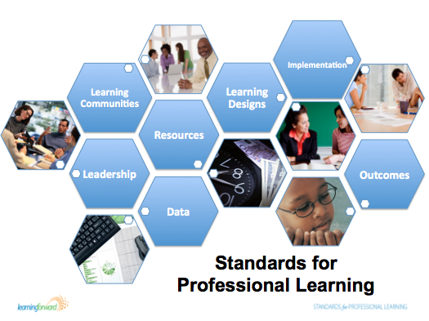


Slide 2
Components of a Comprehensive
Professional Learning System
Conceptual Components
Operational Components
Guidelines
Definition
Decision making
Policies
Vision/Function/Goals
Procedures
Standards
Resources
Funding
Roles & Responsibilities
Continuous improvement
Government
Line of authority
Engagement

Slide 3
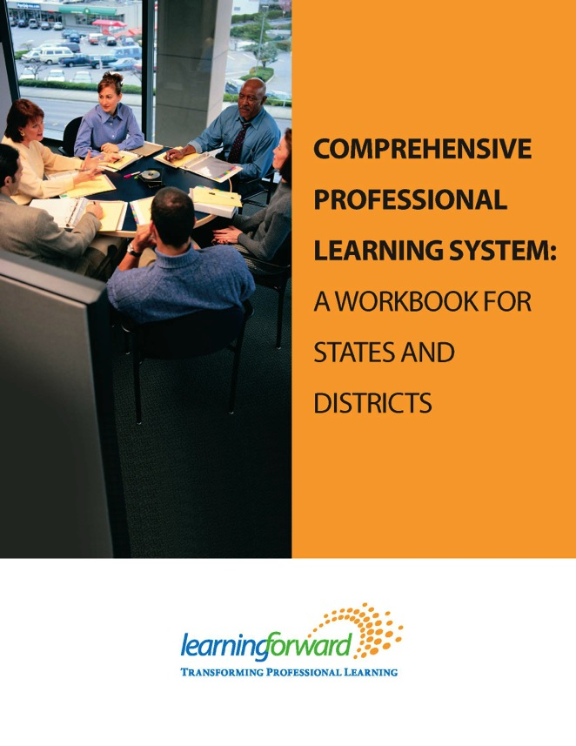
http://learningforward.org/docs/commoncore/professionallearningpolicyreview.pdf

Slide 4
http://learningforward.org/publications/implementing-common-core

Slide 5
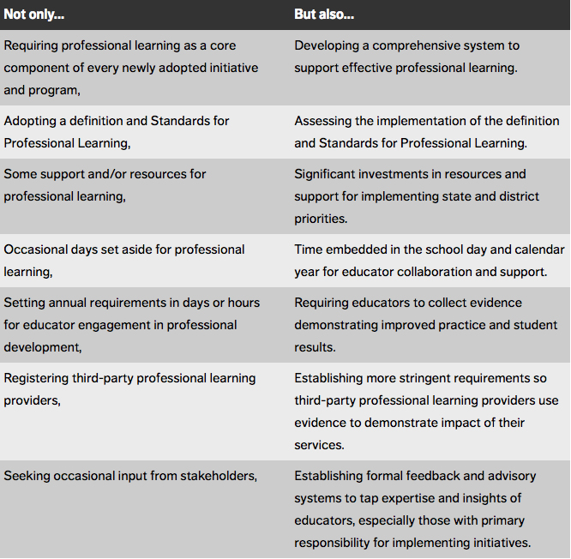
http://blogs.edweek.org/edweek/learning_forwards_pd_watch/2014/02/seven_policy_shifts_that_improve_professional_learning.html

