Slide 1
Opportunities to Create
Next-Generation High Schools
A Toolkit for Education Leaders on the
Personalized Learning Approach
#NextGenHS
@all4ed
@deeperlearning

Slide 2
Overview
This toolkit is intended to be used by district and school leaders and others to
understand the opportunities to advance next-generation high school efforts;
understand how the Every Student Succeeds Act (ESSA) supports state, district, and school efforts;
support high school reform efforts;
support approaches that can improve outcomes for traditionally underserved students;
identify examples of policies, procedures, and practices at the state, district, and school levels that support high school reform; and
provide research, resources, and tools to support local efforts.

Slide 3
Overview
Educators leading high school reform efforts can use these toolkits in very flexible ways.
This toolkit may be used in its totality or broken out into segments.
This toolkit includes a searchable table of contents slide to show the user, up front, topics being addressed.
Built as an online tool, this toolkit allows the user to go directly to any topic and review that portion of the toolkit.
Any part of this toolkit may be repurposed to meet the needs of a particular audience or it can be used to find information on policy or practice related to the topic.

Slide 4
What Are Next-Generation High Schools?
President Obama’s High School Redesign initiative promotes a rethinking of the high school learning experience and challenges schools to
redesign academic content and instructional practices;
personalize learning opportunities;
provide academic and wrap-around support services;
provide high-quality career and college exploration and counseling;
offer opportunities to earn postsecondary credit;
provide career-related experiences or competencies;
strategically use learning time in more meaningful ways; and
provide evidence-based professional development.
Source: http://www.ed.gov/news/press-releases/fact-sheet-redesigning-americas-high-schools (accessed September 6, 2016)

Slide 5
Table of Contents
Click to navigate to a section of interest
What Is Personalized Learning and Why Does It Matter?
Create Conditions Under Which Personalized Learning Efforts Are Most Effective
Personalized Learning: Information for Educators
What Does ESSA Say? Opportunities to Expand Personalized Learning
Moving from Policy to Practice: Promising Approaches
Moving from Grass “Tops” to Grass “Roots”: Policies, Procedures, and Practices
Research and Resources
Planning and Implementation Tools

Slide 6
What Is Personalized Learning and
Why Does It Matter?
Notes:
Under the Every Student Succeeds Act (ESSA) of 2015, states and districts are responsible for supporting and improving the quality of low-performing high schools. Personalized learning approaches can be helpful in engaging all students, including those who traditionally have not succeeded. Educators should study the research and promising practices on personalized learning to determine if this is the best approach for schools.

Slide 7
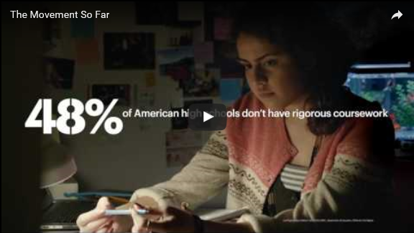
The Movement So Far …
Source: Used with permission from XQ Super School Project, https://www.youtube.com/watch?v=4XDLwUJBUjY (accessed August 24, 2016)

Slide 8

More than 50% of public school students are from low-income families and/or are students of color.
Source: http://nces.ed.gov/programs/coe/indicator_cge.asp (accessed August 24, 2016)

Slide 9
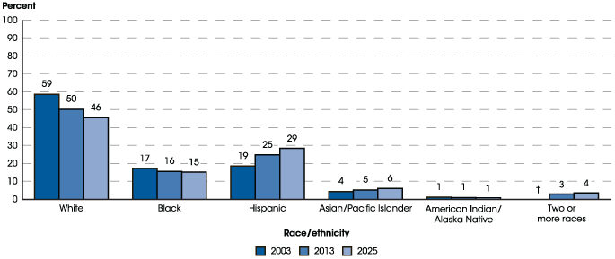
Percentage Distribution of Students Enrolled in Public Elementary and Secondary Schools, by Race/Ethnicity:
Fall 2003, Fall 2013, and Fall 2025
Source: http://nces.ed.gov/programs/coe/indicator_cge.asp (accessed August 24, 2016)
Notes:
† Not applicable.
Note: Race categories exclude persons of Hispanic ethnicity. Prior to 2008, separate data on students of two or more races were not collected. Although rounded numbers are displayed, the figures are based on unrounded estimates. Detail may not sum to totals because of rounding. Data for 2025 are projected.
Source: U.S. Department of Education, National Center for Education Statistics, Common Core of Data (CCD), “State Nonfiscal Survey of Public Elementary and Secondary Education,” 2003–04 and 2013–14; and National Elementary and Secondary Enrollment by Race/Ethnicity Projection Model, 1972 through 2025. See Digest of Education Statistics 2015, table 203.50.

Slide 10
Questions to Consider
As work continues to improve teaching and learning for all students, where does the struggle continue in closing achievement gaps?
Are there places in your work (states, districts, schools, grade levels, etc.) where improved student outcomes are beginning to emerge?
In what ways can personalized learning support be a targeted approach to further enhance your work?

Slide 11
Reflect on Your School(s)
What is the high school graduation rate of your state, district, or school?
What is the high school graduation rate of your traditionally underserved students in your state, district, or school?
Have students who graduated from your school(s) been successful in colleges they attend(ed) or in a career path they entered?

Slide 12
High School Graduation Rates
Continue to Improve in Most States
Thirty-five states saw an increase in overall graduation rates.
Highest and Lowest High School Graduation Rates by State: SY 2014–15
State | Graduation Rate | State | Graduation Rate
Iowa | 90.8% | District of Columbia | 68.5%
New Jersey | 89.7% | New Mexico | 68.6%
Alabama | 89.3% | Nevada | 71.3%
Texas | 89% | Alaska | 75.6%
Nebraska | 88.9% | Colorado | 77.3%
Wisconsin | 88.4% | Arizona | 77.4%
New Hampshire | 88.1% | Louisiana | 77.5%
Source: https://www.whitehouse.gov/sites/whitehouse.gov/files/images/State%20by%20State%20Graduation%20Rates.pdf (accessed October 31, 2016)

Slide 13

13
Nationwide, there are 2,397
high schools that do not graduate
one-third or more of their students.
Source: http://www.gradnation.org/sites/default/files/civic_2016_full_report_FNL2-2_0.pdf (accessed August 25, 2016)

Slide 14
Difference in Achievement Gaps
Between School Years (SYs) 2012–13 and 2013–14
 | Number of states where gap decreased between SYs 2012–13 and 2013–14 | Number of states where gap increased between SYs 2012–13 and 2013–14 | Number of states with no change between SYs 2012–13 and 2013–14
Black-white gap | 28 | 10 | 12
Hispanic-white gap | 32 | 12 | 6
Economically disadvantaged/ All students | 23 | 7 | 20
Limited English proficient/ All students | 23 | 21 | 6
Children with one or more disabilities/All students | 21 | 17 | 12
Source: http://www.ed.gov/news/press-releases/states-continue-improve-graduation-rates-particularly-underserved-students (accessed August 24, 2016).

Slide 15
Nationally, if 90% of the seniors in the Class of 2013 had graduated from high school on time, the nation’s high schools would have produced about 610,000 additional graduates. These additional graduates would have likely produced the following:
Economic Benefits
With at least high school diploma* | With at least some college credits*
$7.2 billion increased income | $9.7 billions increased income
$5.3 billion in increased spending | $7.1 billion increased spending
$16.8 billion in home sales; $800 million increase in auto sales | $23.4 billion in home sales; $1 billion increase in auto sales
$1.8 billion increase in total tax revenue | $2.4 billion increase in total tax revenue
$11.5 billion increase to gross regional product | $15.5 billion increase to gross regional product
65,000 new jobs | 90,000 new jobs
Source: http://impact.all4ed.org/#national/increased-investment/all-students (accessed September 9, 2016)
Notes:
The data above provides the economic benefits for increasing the high school graduation rate for the Class of 2013. The table provides two scenarios: (1) students with only a high school diploma; and (2) students with at least some college credits. Scenario 1 assumes that only some of the additional 610,000 graduates will attain some college credits, a vocational certification, associate’s degree, or bachelor’s degree and beyond. Scenario 2 assumes that all 610,000 additional graduates have completed at least some college credits, while only some will attain a vocational certification, associate’s degree, or bachelor’s degree and beyond.
*The following estimates are annual: Income, spending, vehicle purchases, GRP, job creation, and taxes. Home sales represents the total home purchases by the age of 39.
For state or regional specific data, visit www.impact.all4ed.org.

Slide 16


U.S. high school graduates equal to other countries’ high school dropouts …
Listen
Source: All Things Considered (2016, March 10). Reporter Gabrielle Emanuel http://www.npr.org/programs/all-things-considered/2016/03/10/469898968 (accessed September 8, 2016)

Slide 17

Survey of Student Engagement
Of students surveyed in 2015 29% reported not being engaged, 21% reported being mostly disengaged.
Only 17% of sophomores and juniors strongly agreed that they have the opportunity to do what they do best at school.
Source: http://www.gallup.com/services/189926/student-poll-2015-results.aspx (accessed September 26, 2016)
Notes:
Gallup Student Poll 2015 “Engaged Today – Ready for Tomorrow

Slide 18
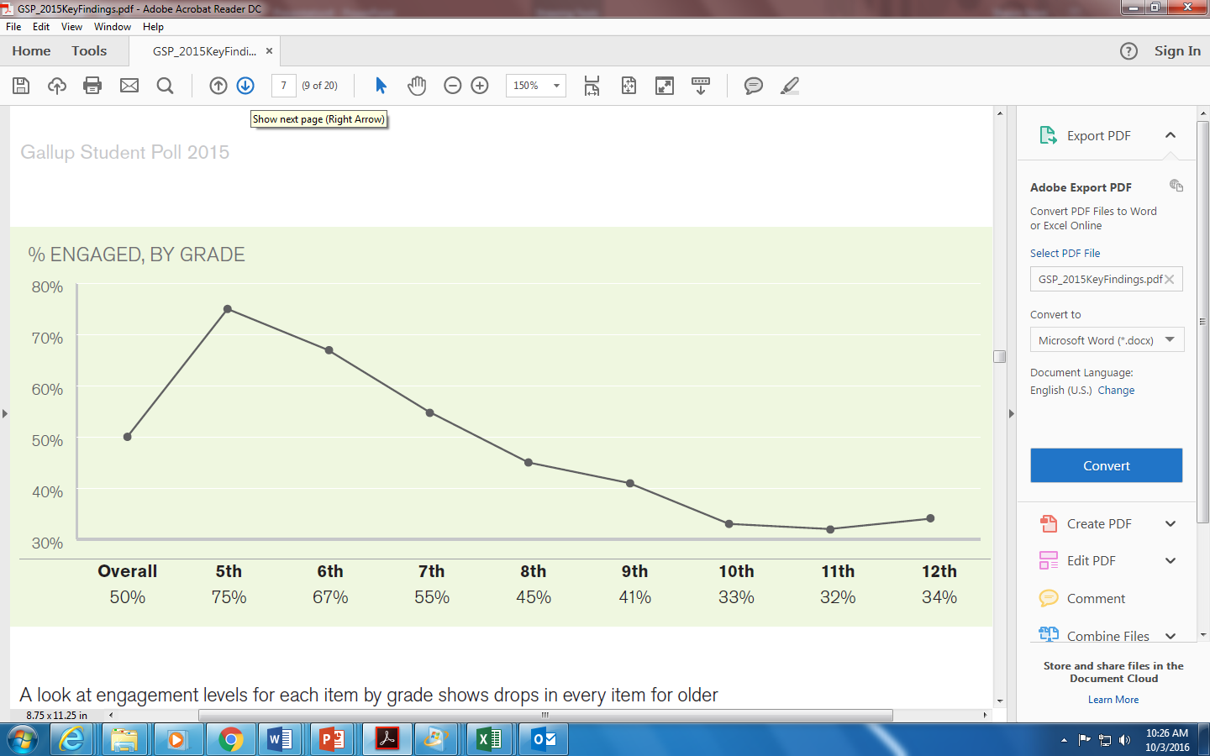
Survey of Student Engagement
Engagement decreases steadily from the fifth grade through junior high and high school.
Source: http://www.gallup.com/services/189926/student-poll-2015-results.aspx (accessed September 26, 2016)

Slide 19

Across the nation, high schools are seeking ways to improve student engagement and facilitate learning that leads to student empowerment and ownership.
19

Slide 20
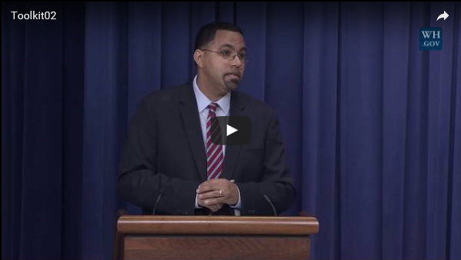
Focus on Equitable Access to High-Quality Teaching and Learning Opportunities for All Students
Source: https://www.whitehouse.gov/photos-and-video/video/2016/09/12/second-annual-white-house-summit-next-generation-high-schools (accessed September 24, 2016)

Slide 21
What Is Personalized Learning?
Personalized learning is a student-centered approach designed to help all students, including those from low-income families and students of color who have been traditionally underserved, develop the knowledge, skills, and abilities that will prepare them for college, a career, and life.
Source: http://all4ed.org/issues/personalized-learning/ (accessed September 16, 2016)

Slide 22
The Personalized Learning Approach
Traditional Systems | Personalized Learning Systems
Mass production | Mass customization
Time is constant (seat time) Achievement is driven by completion of assignments | Time can vary Achievement is driven by mastery/competency
Assembly-line, teacher directed | Innovative, teacher facilitated
End of unit/year/course assessment of knowledge | Embedded, and dynamic assessment of knowledge/skills; demonstration of learning that supports personal aspiration, learning preference, interest
Institution is teacher centered | Institution is student centered
Fixed place; school based | Anywhere and everywhere; mobile
Source: http://www.hanoverresearch.com/media/Best-Practices-in-Personalized-Learning-Environments.pdf (accessed September 16, 2016)

Slide 23
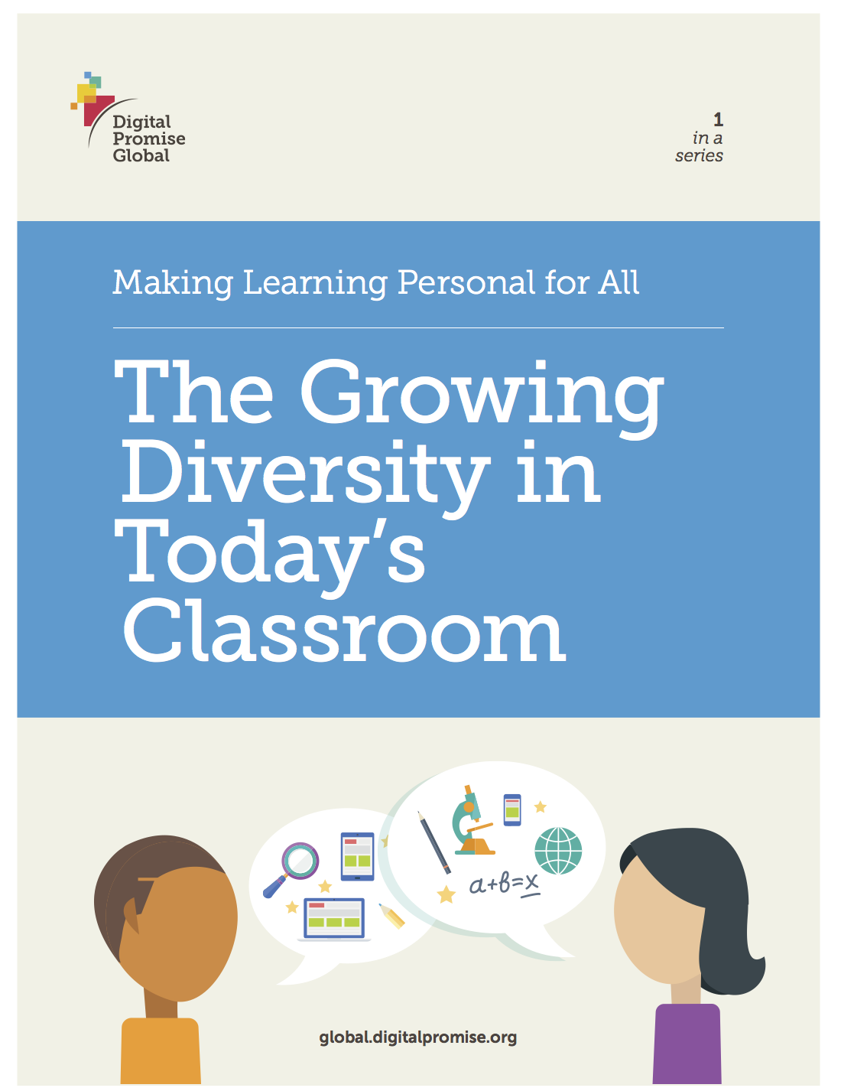
The Need for Personalization Is Growing
Even the most capable educator cannot meet the demand for personalization without schools shifting to a more student-centered model of instruction.
Source: http://digitalpromise.org/wp-content/uploads/2016/09/lps-growing_diversity_FINAL-1.pdf (accessed September 23, 2016)

Slide 24
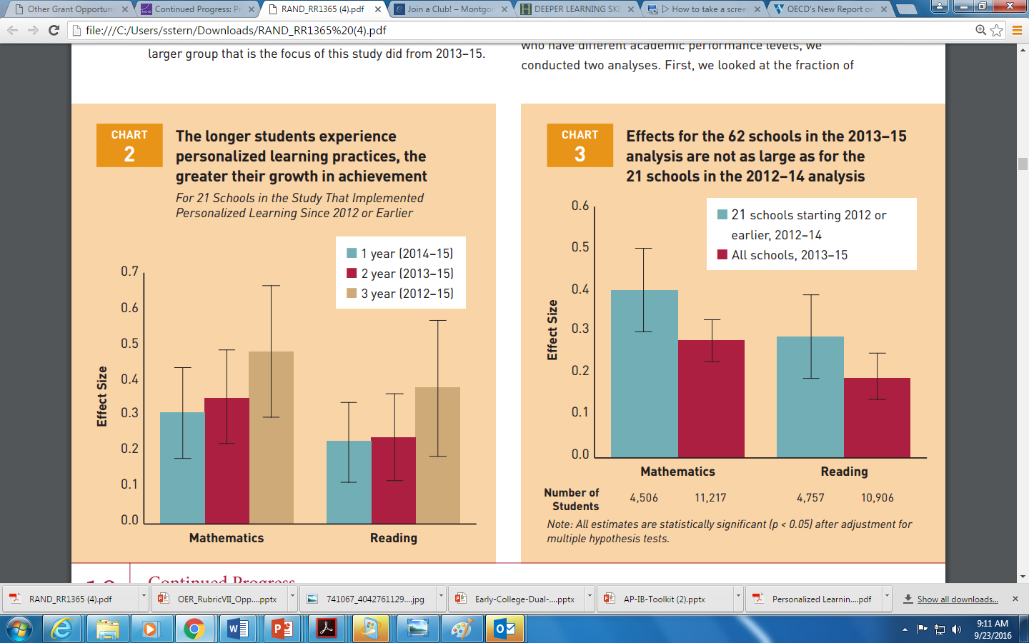
Results from personalized learning require time.
Source: http://www.rand.org/pubs/research_reports/RR1365.html (accessed September 23, 2016)

Slide 25
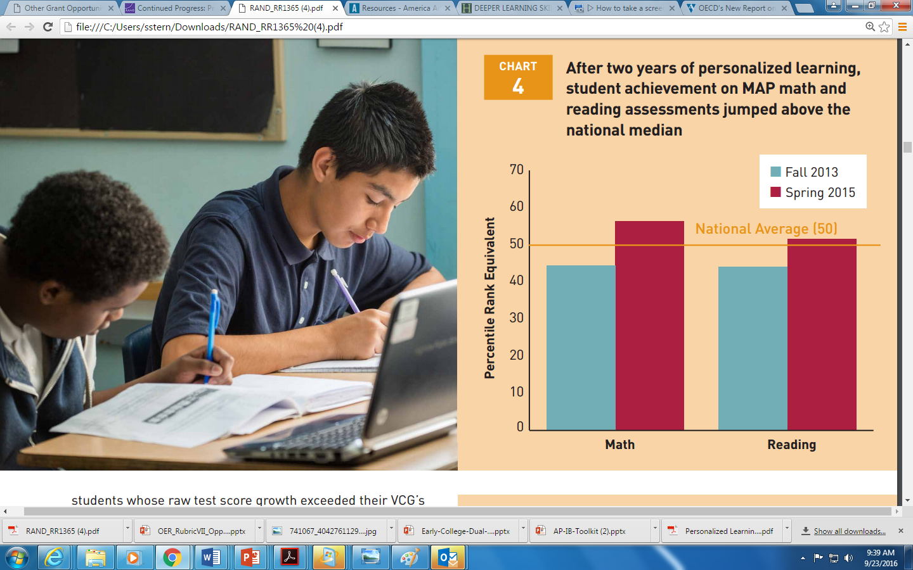
Student achievement on Measures of Academic Progress (MAP) mathematics and reading assessments jumped above the national median.
Source: http://www.rand.org/pubs/research_reports/RR1365.html
(accessed September 23, 2016)

Slide 26
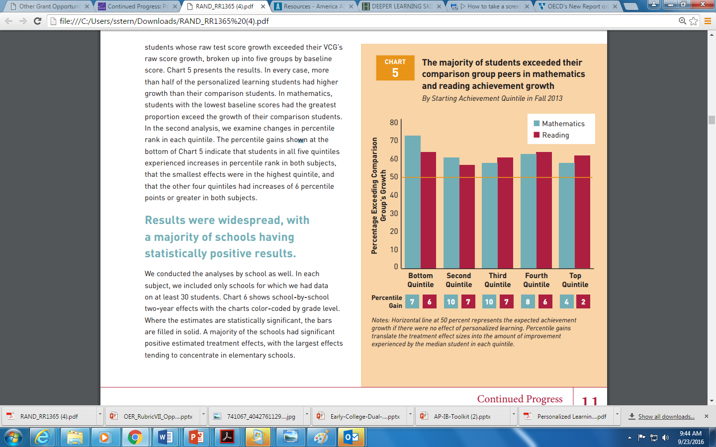
Data shows that the majority of students exceed peers in mathematics and reading achievement growth when they have a personalized learning education environment.
Source: http://www.rand.org/pubs/research_reports/RR1365.html(accessed September 23, 2016)

Slide 27

We live in a global economy and we must provide deeper learning experiences for all students.
27
Source: http://deeperlearning4all.org/about-deeper-learning (accessed September 23, 2016)

Slide 28
What Is Deeper Learning?
Deeper learning entails the delivery of challenging academic standards to students in innovative ways that allow them to learn and apply what they have learned.
The student population in the United States is increasingly diverse and there is a moral and economic imperative of ensuring that all students, including those traditionally underserved are also achieving deeper learning outcomes.
Source: http://deeperlearning4all.org/wp-content/uploads/2016/04/FINAL-ESSA_FactSheet_DeeperLearning.pdf (accessed September 24, 2016)

Slide 29

Deeper learning outcomes are correlated to the knowledge, skills, and abilities that employers are seeking today.
Personalized learning is one approach to achieving deeper learning outcomes.
29

Slide 30



Understanding Personalized Learning
Personalized learning requires a willingness among educators to fully understand each student, their individual skills, and aspirations to help them attain college and career readiness.
Source: December 2015 Widmeyer Communications online survey of 750 underserved parents (MoE +/-3.6%) and 350 teachers of underserved students (MoE +/-5.2%) – Alliance for Excellent Education

Slide 31

By 2025, 68% of jobs will require postsecondary education and training beyond high school.
Source: https://cew.georgetown.edu/
states-initiative/ (accessed
September 23, 2016)

Slide 32

Less than 10% of children born in the bottom quartile of household incomes attain a bachelor’s degree by age 25, compared to more than 50% in the top quartile.
Source: http://www.ed.gov/news/press-releases/fact-sheet-expanding-college-access-through-dual-enrollment-pell-experiment (accessed September 3, 2016)

Slide 33
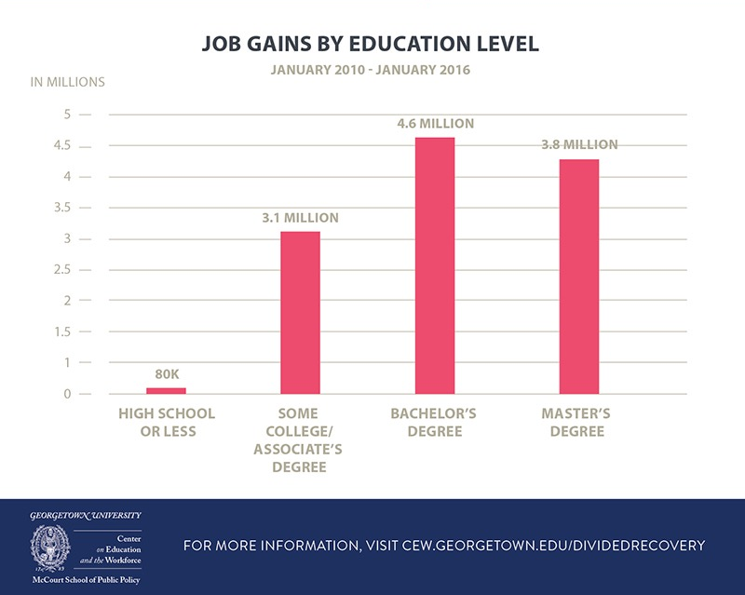
Source: https://cew.georgetown.edu/cew-reports/americas-divided-recovery (accessed August 24, 2016)

Slide 34
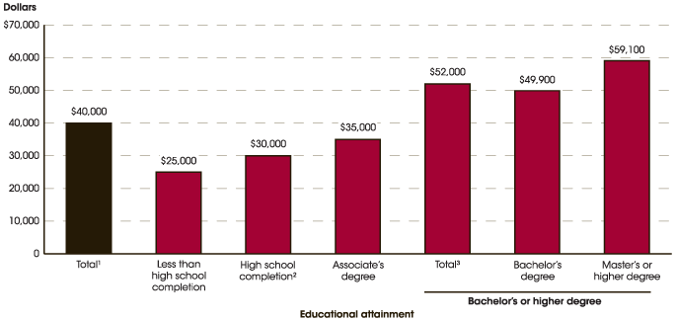
Median Annual Earnings of Full-time, Year-round Workers Ages 25–34, by Educational Attainment: 2014
Source: http://nces.ed.gov/programs/coe/indicator_cba.asp (accessed August 24, 2016))

Slide 35
Create Conditions Under Which
Personalized Learning Efforts
Are Most Effective

Slide 36
Personalized Learning Is
Most Effective When It Is …
Guided by educators and family members in and out of schools
Supported by administrators and networks that extend educators’ capacity to teach
Aligned with myriad interests and abilities of each learner
Informed by research findings from the learning sciences
Source: http://digitalpromise.org/wp-content/uploads/2016/09/lps-growing_diversity_FINAL-1.pdf
(accessed September 23, 2016)​

Slide 37
Creating Conditions for
Personalized Learning
Understand each student’s personal and academic background, strengths, interests, and needs. Help each student take ownership.
Provide each student with targeted instruction, practice, and support in areas where they need help, while ensuring they learn challenging academic content and skills.
Create more flexible learning opportunities inside and outside the classroom, including one-on-one, peer-to-peer, small group, and online instruction.
Connect students to their local community by engaging them in real-world learning opportunities, such as internships, apprenticeships, and hands-on projects.
Source: http://all4ed.org/issues/personalized-learning/key-resources/about-personalized-learning/ (accessed September 16, 2016)

Slide 38
Creating Conditions for
Personalized Learning
Engage teachers in the development and implementation of personalized learning approaches.
Provide ongoing opportunities for teachers to engage in meaningful professional learning opportunities related to personalizing instructions.
Source: www.all4ed.org (accessed September 16, 2016)

Slide 39

And Most Importantly …
Develop trusting and caring relationships with students, who, because of positive relationships with educators, are likely to put more effort into school.
Source: http://all4ed.org/issues/personalized-learning/key-resources/about-personalized-learning/ (accessed September 16, 2016)

Slide 40

Planning & Facilitation
While personalized learning is not teacher-directed, teaching practice is essential for its successful implementation.
Teachers must use data to plan and facilitate instruction on content and skills, based on student needs.
Source: www.all4ed.org (September 23, 2016)
Notes:
Extensive teacher planning is required for facilitation of personalized learning activities. It requires teachers to continue to provide direct teaching of content, concepts, and skills. Personalized teaching does not mean students are on their own; teachers must use data to determine where direct instruction and interventions are needed and use a differentiated approach to instruction to deliver content.

Slide 41
High-Quality Teaching Matters
Black, Latino, and American Indian or Alaska Native students are more likely to attend schools with higher concentrations of inexperienced teachers.
11% of black students, 9% of Latino students, and 7% of American Indian or Alaska Native students attend schools where more than 20% of teachers are in their first year of teaching, compared to 5% of white students and 4% of Asian students.
10% of teachers in schools with high black and Latino student enrollment are in their first year of teaching, compared to 5% of teachers in schools with low black and Latino student enrollment.
Source: http://www2.ed.gov/about/offices/list/ocr/docs/2013-14-first-look.pdf (accessed August 24, 2016)

Slide 42
Personalized Learning:
Information for Educators

Slide 43
Research on Personalized Learning
Early research on the impact of personalized Learning on student achievement is promising:
Students in personalized learning schools made greater progress when compared to their peers.
Some students who started below grade expectations were performing at or above national averages.
The longer students experienced high-quality personalized learning, the greater their growth.
Source: http://www.rand.org/pubs/research_reports/RR1365.html (accessed September 16, 2016)

Slide 44
Research on Personalized Learning
These five strategies undergird implementation of personalized learning:
Learner profiles
Personal learning paths
Competency-based progression
Flexible learning environment
Emphasis on college and career readiness
Each strategy encompasses a set of tools and features of a personalized learning environment.
Source: http://www.rand.org/pubs/research_reports/RR1365.html (accessed September 16, 2016)

Slide 45
Research on Personalized Learning
Overall, data collected on student achievement shows positive effects on student mathematics and reading performance;
lowest-performing students made substantial gains relative to their peers.
Source: http://www.rand.org/pubs/research_reports/RR1365.html (accessed September 16, 2016)

Slide 46
Research on Personalized Learning
Adoption of personalized learning practices varied considerably.
Personalized learning practices that are direct extensions of current practice were more common.
Implementation of some of the more challenging personalized learning strategies was less common.
Source: http://www.rand.org/pubs/research_reports/RR1365.html (accessed September 16, 2016)

Slide 47
Research on Personalized Learning
These three elements of personalized learning support positive outcomes when implemented together and have the greatest ability to isolate the success cases of personalized schools from the other schools.
Student grouping
Learning space supports
Students discussion of data
Source: http://www.rand.org/pubs/research_reports/RR1365.html (accessed September 16, 2016)

Slide 48
Research on Personalized Learning
Personalized learning teachers were more likely than others in a national sample to use technology for personalization and to report use of instructional practices that support competency-based learning.
Personalized learning students were more likely to report that their mathematics and English language arts instruction incorporated aspects of complex, student-centered instruction most of the time or always.
Source: http://www.rand.org/pubs/research_reports/RR1365.html (accessed September 16, 2016)​

Slide 49

Personalized Learning and ...

Slide 50
… the Need for Rigor …
Personalized learning will not help students if they are working with content that is below their learning capacity. Rigor and personalization must go hand in hand.
Start with standards, not structures.
Ensure appropriate level of rigor.
Source: http://educationnext.org/beware-the-iconography-trap-of-personalized-learning-rigor-matters/ (accessed September 23, 2016)

Slide 51
… and Caution
Personalization requires educators to know students.
Not all learners prefer or profit from controlling their own learning tasks; forcing control on them can be counterproductive. Learners may regulate their learning poorly, exert control in a misguided fashion, and thus fail to achieve the desired result.
Source: http://educationnext.org/personalization-future-learning/ (accessed September 23, 2016)

Slide 52
Strike a Thoughtful Balance
“
When I use the term “personalized learning,” I do not picture a form of education that sets aside core knowledge and rigorous content standards for the sake of allowing students to pursue personal interests. Catering to students’ interests and passions can be a powerful means for engaging and motivating students. But that form of personalization should not compromise students’ mastery of core knowledge.
—Thomas Arnett, June 15, 2016
”
Source: http://educationnext.org/personalized-learning-and-sound-curriculum-two-sides-of-the-same-coin/
(accessed September 23, 2016)​

Slide 53
Provide Supportive Learning Environment
Institute for Student Achievement (ISA) offers one model that includes
choice;
differentiated instruction;
blended learning;
customized curriculum; and
advocate-advisory program.
Source: http://www.studentachievement.org/approach/isa-evidence-based-whole-school-reform-model/ (accessed September 27, 2016)

Slide 54
Institute for Student Achievement
Approach to Personalized Student Learning
Choice
Choice is built into the curriculum so that learning builds on individual students' interests and passions.
Blended Learning
Opportunities enable students to learn through classroom and online learning, individually and in small groups.
Advocate-Advisory Program
Differentiated Instruction
Students advance based on their demonstrated knowledge and skills and receive scaffolding and personal support where they struggle.
Customized Curriculum
Teachers facilitate customization of curriculum tailored to students' interests and learning needs.
Students' advisory class provides them with support and a sense of belonging to a community of peers.
Advisors support students' success by guiding their experience and problem solving with them.
All students have an adult-advisor-advocate who knows them well, is their go-to person, and the family liaison.
Source: http://www.studentachievement.org/approach/isa-evidence-based-whole-school-reform-model/ (accessed September 27, 2016)

Slide 55
What are the essential pinnacles of Personalized Learning?
55
Personalized Learning: Perspectives of Teachers and Parents
Widmeyer Communications Survey Results

Slide 56
Personalized Learning: Survey Responses
Respondents were asked: “Being as specific as possible, what does the term “personalized learning” mean to you? If you do not know, please give your best guess.”
Source: December 2015 Widmeyer Communications online survey of 750 underserved parents (MoE +/-3.6%) and 350 teachers of underserved students (MoE +/-5.2%) – Alliance for Excellent Education

Slide 57
Regardless of whether they are using our definition of personalized learning, this is not an alien concept. About 70% of teachers are either definitely (31%) or think they are (39%) using personalized learning, and about half of parents think this is practiced in their children’s classrooms.
Personalized Learning: Survey Responses
Source: December 2015 Widmeyer Communications online survey of 750 underserved parents (MoE +/-3.6%) and 350 teachers of underserved students (MoE +/-5.2%) – Alliance for Excellent Education
Notes:
While some teachers and schools may be engaged in some elements of personalized learning, helping them understand that it is a much different approach than traditional ones is a challenge but an important one to tackle.

Slide 58

Essential Elements of Personalized Learning
Student agency
Student ownership
Learning profile
Learning paths
Source: http://www.edweek.org/ew/articles/2014/10/22/09pl-overview.h34.html (accessed September 16, 2016)

Slide 59
Essential Elements of Personalized Learning
Student agency. Students have more autonomy through the use of digital tools and other resources that accounts for how they learn best, what motivates them, and their academic goals.
Student ownership. Teachers' roles are more like those of coaches or facilitators rather than content providers.
Learning profile. Students record their goals, academic strengths and areas for growth, and motivations.
Learning paths. Students set and manage their individual academic goals and learning activities.
Source: http://www.edweek.org/ew/articles/2014/10/22/09pl-overview.h34.html (accessed September 16, 2016)

Slide 60

Other Considerations for Implementing Personalized Learning
Alignment
Customization
Pace
Data
Access
Source: http://www.knowledgeworks.org/sites/default/files/u1/teacher-conditions.pdf (accessed September 16, 2016)

Slide 61
Other Considerations for Implementing Personalized Learning
Alignment. Instruction is aligned with rigorous college- and career-ready standards and with the social and emotional skills students need to be successful in college and a career.
Customization. Instruction is customized, allowing each student to design learning experiences aligned with his or her interests.
Pace. Instructional pace varies based on individual student needs, allowing students to accelerate or take additional time based on their level of mastery or need.
Source: http://www.knowledgeworks.org/sites/default/files/u1/teacher-conditions.pdf (accessed September 16, 2016)

Slide 62
Other Considerations for
Personalized Learning
Data. Educators use data from formative assessments and student feedback in real time to differentiate instruction, and provide robust supports and interventions so that every student remains on track to high school graduation.
Access. Students and parents have access to clear learning objectives and assessment results so they understand what is expected for mastery and advancement.
Source: http://www.knowledgeworks.org/sites/default/files/u1/teacher-conditions.pdf (accessed September 16, 2016)

Slide 63

Academic Supports for
Personalized Learning
Personalized learning can meet the needs of all students when schools provide targeted instruction, practice, and support in areas where these students need help, and still ensure that they learn challenging academic content and skills.
Source: Alliance for Excellent Education, September 2016

Slide 64


When Personalized Learning Is Done Well
Students …
demonstrate agency and ownership over their own learning;
solve problems that are relevant to their present and future;
learn through social interaction and collaboration; and
feel motivated, challenged, and joyful about learning and school.
Teachers …
enable students to take increasing ownership of their learning path and pace;
pursue a broader definition of student success that includes college- and career-aligned knowledge, skills, and habits of success; and
design schools and classrooms around student ownership of learning and based on student needs and feedback.
Source: http://k12education.gatesfoundation.org/student-success/
personalized-learning/schools-systems/ (accessed September 16, 2016)

Slide 65


When Personalized Learning Is Done Well
School leaders …
enable teachers to design personalized learning environments;
create innovation oriented cultures where teachers can collaborate, test new approaches, and learn together;
create systems to support teacher growth and development of the knowledge, skills, and mindsets that enable personalized learning; and
effectively manage change.
Systems leaders …
create conditions of school autonomy, support, and accountability to enable learning environment innovation;
attract, develop, and retain innovative leaders; and
build an infrastructure and organizational processes to support seamless delivery of high-quality instructional content and tools into the hands of teachers and students.
Source: http://k12education.gatesfoundation.org/student-success/personalized-learning/schools-systems/
(accessed September 16, 2016)

Slide 66
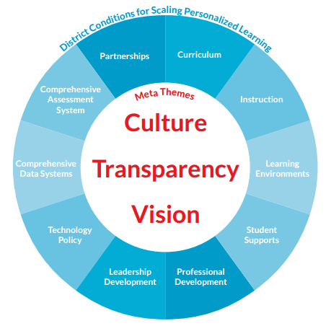
District Conditions for Scaling
Personalized Learning
Survey results from
The Shifting Paradigm of Teaching: Personalized Learning According to Teachers
Source: http://blogs.edweek.org/teachers/teaching_now/2016/07/teachers_
personalized_learning_report.html (accessed September 16, 2016)

Slide 67
What Does ESSA Say?:
Opportunities to Expand
Personalized Learning

Slide 68

ESSA Provisions on Personalized Learning: Federal Flash
Source: https://www.youtube.com/watch?v=XFKf0iaPeUU (accessed September 16, 2016)

Slide 69

ESSA Opportunities
Professional development funding may be used to provide training “on effective strategies to integrate rigorous academic content, career and technical education, and work-based learning (if appropriate), which may include providing common planning time … ”
Source: ESSA, Sec. 2103(b)(3)(O)

Slide 70
ESSA Personalized Learning Opportunities with Funding
Under ESSA, a state may use up to 3% of its Title I funds for “direct student services,” including “components of a personalized learning approach.”
States award grants to geographically diverse districts to use these funds.
Source: ESSA, Sec. Sec. 1003A(c)(3)(D)

Slide 71
ESSA Personalized Learning
Opportunities with Funding
Districts may also use Direct Student Services funds to support the following:
Student enrollment and participation in academic courses not otherwise available at a school, including advanced course work
Activities that assist students in completing credit-bearing postsecondary education–level instruction, such as Advanced Placement (AP) and International Baccalaureate (IB) courses, including covering test fees
Source: ESSA, Sec. Sec. 1003A(c)(3)

Slide 72
Accountability and Personalized Learning
ESSA requires a multiple-measure accountability system that must include at least one indicator of school quality or success selected by the state, in addition to students’ performance on the statewide assessment, high school graduation rates, and English language proficiency. This gives states the flexibility to include indicators in its statewide accountability system that reflect the impact of personalized learning.
Source: http://all4ed.org/wp-content/uploads/2016/06/FINAL-ESSA_FactSheet_Personalized-Learning.pdf (accessed September 16,2016)

Slide 73
Moving from Policy to Practice:
Promising Approaches

Slide 74
What Can Be Done to
Personalize Learning?
?
?
?
?
?
?

Slide 75
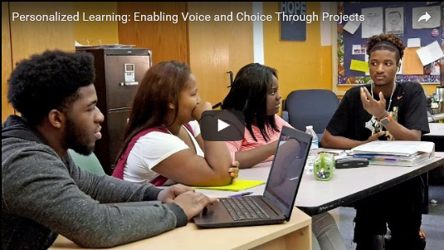
Personalized Learning:
Big Picture High School (Nashville, TN)
Source: https://www.youtube.com/watch?v=UCeM4lyvaAE (accessed September 16, 2016)

Slide 76
Personalizing Learning Through
Project-Based Instruction:
Talladega County Schools (GA)
Keys to Success
Partner with and learn from the challenges and successes of other schools.
Involve teacher and student voices.
Develop a technology-rich, project-based learning model.
Build community support.
Invest in teacher training.
Source: http://all4ed.org/reports-factsheets/talladega/​ (accessed September 24, 2016)

Slide 77

Personalized Learning:
Winterboro High School (Talladega, GA)
Source: https://www.youtube.com/watch?v=8VfYPZDlg1M&feature=youtu.be (accessed September 24, 2016)

Slide 78
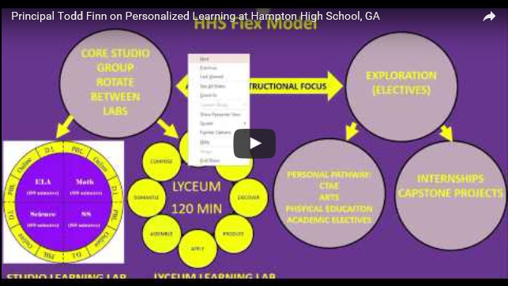
Personalized Learning:
Hampton High School (Henry County, GA)
Source: https://www.youtube.com/watch?v=IqfeEZosO-E(accessed September 23, 2016)

Slide 79
Personalized Learning District Policy: Chugach School District (AK)
Chugach School District in rural Alaska developed a performance-based learning system by creating, implementing, and fine-tuning thematic units, tools, assessments, and instructional approaches, and replacing the Carnegie unit and grade levels with ten performance levels.
Source: http://www.ed.gov/oii-news/competency-based-learning-or-personalized-learning (accessed September 16, 2016)

Slide 80
Personalized Learning District Policy:
Dallas, TX
Dallas Independent School District created the following objectives that align with its goal of leveraging personalized learning models to increase college and career readiness among all students.
By 2015, ensure that at least four new or existing elementary, middle, and/or high schools feature personalized learning, serving at least 1% of the student body.
By 2020, scale personalized learning to twenty new or existing schools to serve at least 10% of the student body.
Source: http://nextgenlearning.org/sites/default/files/grants_download/Gate%20Next%20Gen%20Systems%20Challenge%
20paper%20(lo-res).pdf (accessed September 16, 2016)

Slide 81
Personalized Learning State Policies: New Hampshire and Michigan
New Hampshire is initiating high school redesign that replaces the time-based system (Carnegie unit) with a competency-based system focused on personalized learning, strong teacher-student relationships, flexible supports, and development of twenty-first-century skills.
Michigan passed legislation in 2010 providing a seat-time waiver to districts that want to offer pupils access to online learning options and the opportunity to continue working on a high school diploma or grade progression without physically attending a school facility.
Source: http://www.ed.gov/oii-news/competency-based-learning-or-personalized-learning (accessed September 16, 2016)
Notes:
Additional links here and here.

Slide 82
Personalized Learning State Policy: Ohio
Ohio’s credit flexibility plan, adopted by the State Board of Education in 2009, allows students to earn high school credit by demonstrating subject-area competency, completing classroom instruction, or a combination of the two. Under this plan, subject-area competency can be demonstrated by participation in alternative experiences including internships, community service, online learning, educational travel, and independent study.
Source: http://www.ed.gov/oii-news/competency-based-learning-or-personalized-learning (accessed September 16, 2016)

Slide 83
Practices that Support
Personalized Learning: Dallas, TX
Dallas Independent School District (DISD) is in the process of creating an “Office of Transformation and Innovation” to formalize district support for personalized learning. The cross-functional office will work directly with schools as well as other departments at the district level.
Source: http://nextgenlearning.org/sites/default/files/grants_download/Gate%20Next%20Gen%20Systems%20
Challenge%20paper%20(lo-res).pdf (accessed September 16, 2016)

Slide 84
Procedures that Support
Personalized Learning: Dallas, TX
A team of district leaders and external partners from Southern Methodist University, Dallas Regional Chamber, design experts, and human capital organizations provides oversight throughout the personalized learning implementation and scaling process in Dallas Independent School District.
Source: http://nextgenlearning.org/sites/default/files/grants_download/Gate%20Next%20Gen%20Systems%
20Challenge%20paper%20(lo-res).pdf (accessed September 16, 2016)

Slide 85

Moving from Grass “Tops” to Grass “Roots”: Policies, Procedures, and Practices

Slide 86
Considerations for Changes in System
States, districts, or schools can
ensure students have a personalized learning plan;
build educator and school leader capacity;
rethink systems of assessment; and
align data systems with student-centered learning.
Source: http://nextgenlearning.org/sites/default/files/grants_download/Gate%20Next%20Gen%20Systems%20
Challenge%20paper%20(lo-res).pdf (accessed September 16, 2016)

Slide 87

Considerations for Changes in
Structures and Policies
Source: https://www.youtube.com/watch?v=OUJPKvrV-rY (accessed September 23, 2016)

Slide 88
What examples of policy, procedures, and/or practices are addressed in this toolkit’s videos?
Policy
Procedure/Practice

Slide 89
What Do Leaders Need to Consider?
What is the vision for student learning in your state, district, or school?
What policies, practices, and procedures can support
  trusting, caring student-teacher relationships that leverage learning;
  collaborative teaching that occurs in personalized learning environments;
  meaningful project-based learning that connects to the local community and real world;
  opportunities for self-paced learning; and
  flexible learning environments—small groups, one-on-one instruction, etc.?
Policies
Practices
Procedures

Slide 90
Consider Your Policies,
Procedures, and Practices
Policies
Procedures
Practices

Slide 91

“
Most high-paying jobs require additional education and training beyond a high school diploma. We must make sure that our children, particularly those who are traditionally underserved, are prepared for and have access to postsecondary education.
—Gov. Bob Wise,
Alliance for Excellent Education
”

Slide 92
Research and Resources

Slide 93
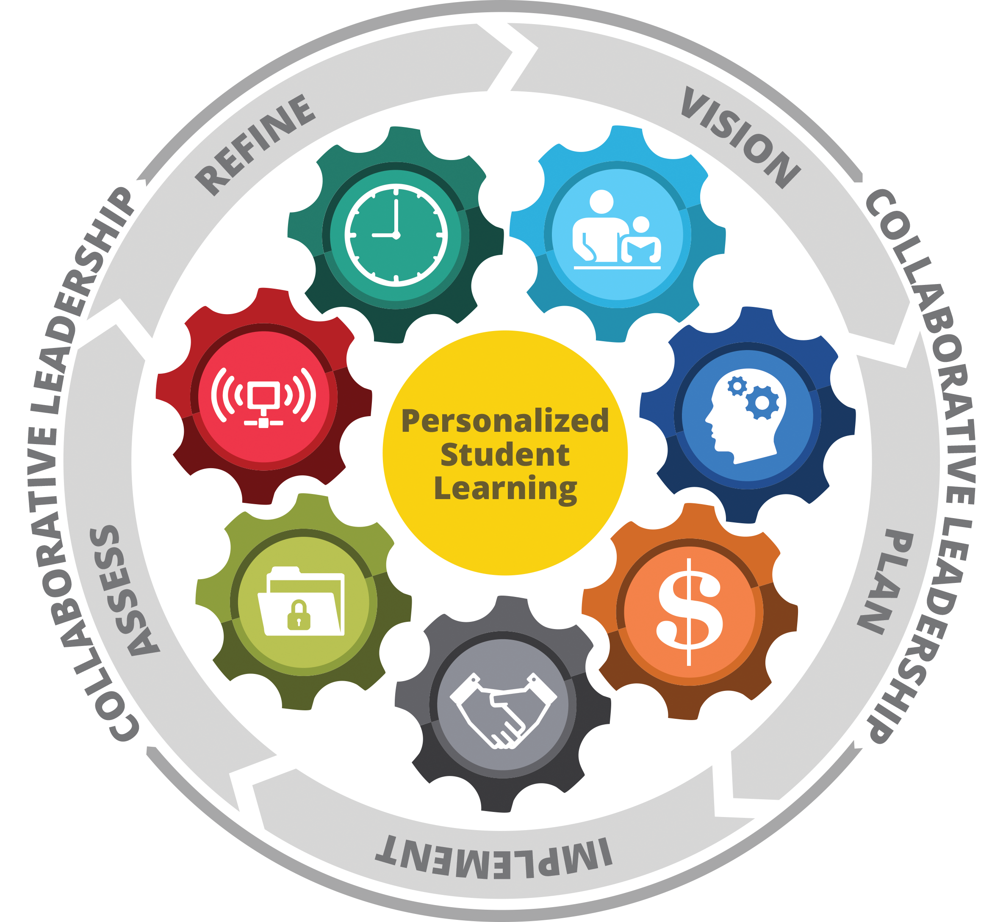
Future Ready Schools® for Personalized Learning
Future Ready Schools® provides free, online tools to help district leaders plan and implement personalized, research-based digital learning strategies so all students can achieve their full potential.
Source: http://dashboard.futurereadyschools.org/framework/framework-overview (accessed September 24, 2016)

Slide 94
Research and Resources
Alliance for Excellent Education
ESSA Primer—Personalized Learning http://all4ed.org/reports-factsheets/every-student-succeeds-act-primer-personalized-learning/
PowerPoint—Personalized Learning: Meeting the Needs of Students with Disabilities and English Learners http://all4ed.org/wp-content/uploads/2016/05/PL-Event-Slides-revised-05.03.16.pdf
Webinar—Personalized Learning: Meeting the Needs of Students with Disabilities and English Learners http://all4ed.org/webinar-event/may-4-2016/
Video/Federal Flash—Federal Flash, Special Edition: ESSA’s support in implementing personalized learning http://all4ed.org/videos/fedederal-flash-special-edition-essas-support-in-implementing-personalized-learning/
Report—Talladega County Schools: Personalizing Student Learning Through Project-Based Instruction http://all4ed.org/reports-factsheets/talladega/

Slide 95
Research and Resources
U.S. Department of Education
Case Studies—Tools for State and District Leaders: Personalized Learning Case Studies http://bit.ly/2aLUhKq
Fact Sheet—Competency-Based Learning or Personalized Learning http://bit.ly/1vp8DqR
Video—Personalized Professional Learning for Future Ready Leaders http://bit.ly/1Y5WbEI
Report—Mapping a Personalized Learning Journey: K-12 Students and Parents Connect the Dots with Digital Learning http://bit.ly/2alBtUd
Learning Tool—Personal Competencies/Personalized Learning Reflection on Instruction http://bit.ly/2aGyfHu
Re-Inventing Schools Coalition Model http://www.ed.gov/oii-news/competency-based-learning-or-personalized-learning

Slide 96
Research and Resources
AASA, The School Superintendents Association
Personalizing 21st Century Education: A Framework For Student Success http://aasa.org/content.aspx?id=39199 and video discussing the book: https://www.youtube.com/watch?v=wNljVl8WDG0
Superintendents Cohort on Personalized Learning
http://www.aasa.org/personalized-learning.aspx
Realizing the Possibility of Personalized Learning https://www.aasa.org/content.aspx?id=37157
American Architectural Foundation
Design for Learning Program http://www.archfoundation.org/category/design-for-learning/ (includes feature on Denver School for Science and Technology http://www.archfoundation.org/2013/01/schools-designed-for-learning-the-denver-school-of-science-and-technology-3/)

Slide 97
Research and Resources
Council of Chief State School Offices
Innovation Lab Network http://www.ccsso.org/Resources/Programs/Personalized_Learning_Experiences.html
Learning Policy Institute
Evidenced-Based Interventions: A Guide for States https://learningpolicyinstitute.org/
sites/default/files/product-files/Evidence_Based_Interventions_Guide_for_States.pdf
National Center for Learning Disabilities
Competency-Based Education and Implications for Students with Learning and Attention Issues http://www.ncld.org/wp-content/uploads/2014/11/
ncld_cbe_recommendations.pdf

Slide 98
Research and Resources
Next Generation Learning Challenges
Resource Hub: Designed for educators looking to explore, adopt and embrace personalized learning. To view the hub and access the resources: http://nextgenlearning.org/personalized-learning
The Center for the Social Organization of Schools at Johns Hopkins University
Diplomas Now Project http://diplomasnow.org/about/what-we-do/

Slide 99
Planning and Implementation Tools

Slide 100
Policies, Procedures, and Practices
In what ways have the moral and economic impacts on participation in personalized learning been provided?
Have examples of the research needed to support buy-in, involvement, and implementation been provided?
Are there staff members who can share their positive experiences related to access to personalized learning approaches for traditionally underserved students?
What types of professional development are needed to support educator involvement and buy-in?

Slide 101
Supporting Educators
101
Provide educators with information about research related to access to personalized learning approaches for traditionally underserved students?
What types of questions or concerns have staff shared?
Are there staff members who can share their positive experiences related to personalized learning approaches for traditionally underserved students?
Do staff members need additional professional development to better support the implementation of personalized learning approaches?

Slide 102
Evaluating Success: Things to Consider
102
How will information about personalized learning approaches be shared with stakeholders (i.e., educators, parents, students, colleges, business community)?
What data points will best support an analysis of implementation efforts?
In what areas can existing partnerships or expertise be leveraged?

Slide 103
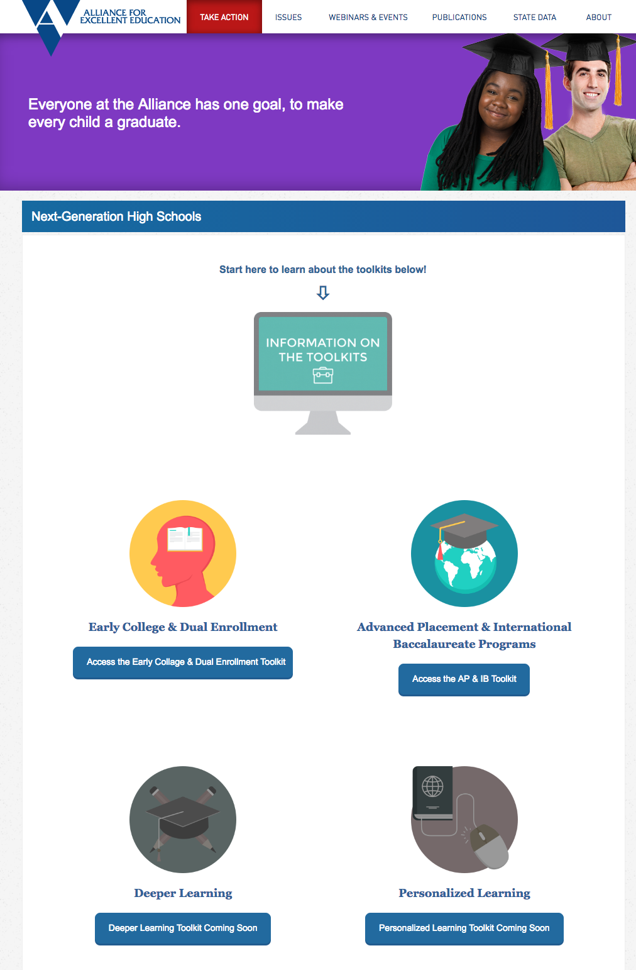
103
For more information
and resources about
personalized learning, visit http://all4ed.org/nghs.
The resources featured in this toolkit represent only a small sample of the tools and research available to policymakers and practitioners from various organizations, states, districts, and schools.
The findings and opinions expressed in the items highlighted here are those of their respective authors and sponsoring organizations and do not necessarily reflect the views of the Alliance for Excellent Education.

Slide 104
Thank You!
104
For further information and
technical coaching,
email alliance@all4ed.org.
All4ed.org
Alliance@all4ed.org
@all4ed

