Slide 1
Opportunities to Create
Next-Generation High Schools
A Toolkit for Education Leaders on
Early College High School and
Dual-Enrollment Programs
#NextGenHS
@all4ed
@deeperlearning

Slide 2
Overview
This toolkit is intended to be used by district and school leaders and others to:
Understand the opportunities to advance next-generation High School efforts.
Understand how to use the Every Student Succeeds Act (ESSA) to support efforts.
Support high school reform efforts.
Support approaches that can improve outcomes for traditionally underserved students.
Identify examples of policies, procedures, and practices at the state, district, and school levels that support high school reform.
Provide research, resources, and tools to support local efforts.

Slide 3
Overview
Educators leading high school reform efforts can use these toolkits in very flexible ways:
Each one may be used in its totality or broken out into segments.
Each toolkit includes a searchable table of contents slide to help the user see, up front, what topics are addressed.
Built as an online tool, the user is able to go directly to any topic and review that portion of the toolkit right away.
Any part of this toolkit may be repurposed to meet the needs of a particular audience or to find information on policy or practice related to the topic.

Slide 4
What Are Next-Generation High Schools?
The High School Redesign initiative promotes a rethinking of the high school learning experience, and challenges schools to:
Redesign academic content and instructional practices.
Personalize learning opportunities.
Provide academic and wrap-around support services.
Provide high-quality career and college exploration and counseling.
Offer opportunities to earn postsecondary credit.
Provide career-related experiences or competencies.
Strategically use learning time in more meaningful ways.
Provide evidence-based professional development.
Source: http://www.ed.gov/news/press-releases/fact-sheet-redesigning-americas-high-schools (accessed September 6, 2016)

Slide 5
Table of Contents
Click to navigate to a section of interest
Moral and Economic Imperative
Rethinking High School: What Can It Mean?
Implementing Early College High Schools and Dual-Enrollment Programs:
Information for Leaders
What Does ESSA Say?: Opportunities to Advance Access to Rigorous Course Work
Moving from Policy to Practice: Promising Approaches
Moving from Grass “Tops” to Grass “Roots”: Policies, Procedures, and Practices
Research and Additional Resources
Planning and Implementation Tools

Slide 6
Moral and Economic Imperative
Notes:
Under the Every Student Succeeds Act (ESSA) of 2015, states and districts are responsible for supporting and improving the quality of low-performing high schools.

Slide 7
Questions to Consider
What outcomes do you hope to accomplish with your high school improvement work?
What would it take to accomplish those outcomes in your state, district, and community?

Slide 8
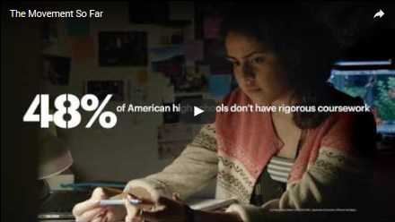
The Moment So Far …
Source: Used with permission from XQ Super School Project, https://www.youtube.com/watch?v=4XDLwUJBUjY (accessed August 24, 2016)

Slide 9

More than 50 percent of public school students are from low-income families and/or are students of color.
Source: http://nces.ed.gov/programs/coe/indicator_cge.asp (accessed August 24, 2016)
Notes:
† Not applicable.
Note: Race categories exclude persons of Hispanic ethnicity. Prior to 2008, separate data on students of two or more races were not collected. Although rounded numbers are displayed, the figures are based on unrounded estimates. Detail may not sum to totals because of rounding. Data for 2025 are projected.
Source: U.S. Department of Education, National Center for Education Statistics, Common Core of Data (CCD), “State Nonfiscal Survey of Public Elementary and Secondary Education,” 2003–04 and 2013–14; and National Elementary and Secondary Enrollment by Race/Ethnicity Projection Model, 1972 through 2025. See Digest of Education Statistics 2015, table 203.50.

Slide 10
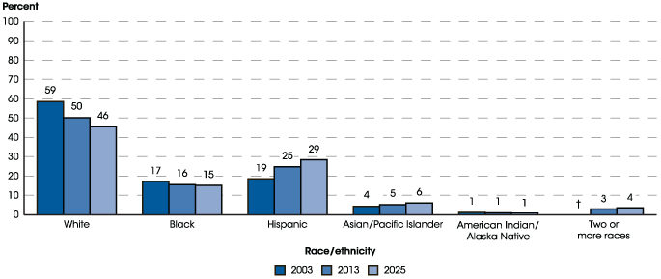
Percentage Distribution of Students Enrolled in Public Elementary and Secondary Schools, by Race/Ethnicity:
Fall 2003, Fall 2013, and Fall 2025
Source: http://nces.ed.gov/programs/coe/indicator_cge.asp (accessed August 24, 2016)
Notes:
† Not applicable.
Note: Race categories exclude persons of Hispanic ethnicity. Prior to 2008, separate data on students of two or more races were not collected. Although rounded numbers are displayed, the figures are based on unrounded estimates. Detail may not sum to totals because of rounding. Data for 2025 are projected.
Source: U.S. Department of Education, National Center for Education Statistics, Common Core of Data (CCD), “State Nonfiscal Survey of Public Elementary and Secondary Education,” 2003–04 and 2013–14; and National Elementary and Secondary Enrollment by Race/Ethnicity Projection Model, 1972 through 2025. See Digest of Education Statistics 2015, table 203.50.

Slide 11
High School Graduation Rates
Continue to Improve in Most States
Thirty-five states saw an increase in overall graduation rates.
Highest and Lowest High School Graduation Rates by State: SY 2014–15
State | Graduation Rate | State | Graduation Rate
Iowa | 90.8% | District of Columbia | 68.5%
New Jersey | 89.7% | New Mexico | 68.6%
Alabama | 89.3% | Nevada | 71.3%
Texas | 89% | Alaska | 75.6%
Nebraska | 88.9% | Colorado | 77.3%
Wisconsin | 88.4% | Arizona | 77.4%
New Hampshire | 88.1% | Louisiana | 77.5%
Source: https://www.whitehouse.gov/sites/whitehouse.gov/files/images/State%20by%20State%20Graduation%20Rates.pdf (accessed October 31, 2016)

Slide 12
Difference in Achievement Gaps Between
School Years (SYs) 2012–13 and 2013–14
 | Number of states where gap decreased between SYs 2012–13 and 2013–14 | Number of states where gap increased between SYs 2012–13 and 2013–14 | Number of states with no change between SYs 2012–13 and 2013–14
Black–white gap | 28 | 10 | 12
Hispanic–white gap | 32 | 12 | 6
Economically disadvantaged/ All students | 23 | 7 | 20
Limited English proficient/ All students | 23 | 21 | 6
Children with one or more disabilities/All students | 21 | 17 | 12
Source: U.S. Department of Education, Office of Elementary and Secondary Education, http://www.ed.gov/news/press-releases/states-continue-improve-graduation-rates-particularly-underserved-students (accessed August 24, 2016)

Slide 13

Black, Latino, and American Indian or Alaska Native students are more likely to attend schools with higher concentrations of inexperienced teachers.
Eleven percent of black students, 9 percent of Latino students, and 7 percent of American Indian or Alaska Native students attend schools where more than 20 percent of teachers are in their first year of teaching, compared to 5 percent of white students and 4 percent of Asian students.
Source: http://www2.ed.gov/about/offices/list/ocr/docs/2013-14-first-look.pdf (accessed August 24, 2016)

Slide 14

Ten percent of teachers in schools with high black and Latino student enrollment are in their first year of teaching, compared to 5 percent of teachers in schools with low black and Latino student enrollment.
Source: http://www2.ed.gov/about/offices/list/ocr/docs/2013-14-first-look.pdf (accessed August 24, 2016)

Slide 15

15
Nationwide, there are 2,397 high schools, , that do not graduate one-third or more of their students.
Source: http://www.gradnation.org/sites/default/files/civic_2016_full_report_FNL2-2_0.pdf (accessed August 25, 2016)

Slide 16
Nationally, if 90 percent of the seniors in the Class of 2013 had graduated from high school on time, the nation’s high schools would have produced about 610,000 additional graduates. These additional graduates would have likely produced the following:
With at least high school diploma | With at least some college credits
$7.2 billion increased income | $9.7 billions increased income
$5.3 billion in increased spending | $7.1 billion increased spending
$16.8 billion in home sales; $800 million increase in auto sales | $23.4 billion in home sales; $1 billion increase in auto sales
$1.8 billion increase in total tax revenue | $2.4 billion increase in total tax revenue
$11.5 billion increase to gross regional product | $15.5 billion increase to gross regional product
65,000 new jobs | 90,000 new jobs
Individual dual-enrollment and early college high school graduates would experience tremendous cost savings:
One full year of dual-enrollment can save a student between $5,000 and $24,000 in college costs¹
Early college high school graduates save about 30 percent off of the cost of a BA and 60 percent off of an associates degree²
Source: http://impact.all4ed.org/#national/increased-investment/all-students (accessed September 3, 2016)
Notes:
The data above provides the economic benefit for increasing the graduation rate for the class of 2013. The table provides two scenarios: 1) students with only a high school diploma; 2) students with at least some college credits. Scenario one assumes that only some of the additional 610,000 graduates will attain some college credits, a vocational certification, associate’s degree, or bachelor’s degree and beyond. Scenario two assumes that all 610,000 additional graduates have completed at least some college credits, while only some will attain a vocational certification, associate’s degree, or bachelor’s degree and beyond.
The following estimates are annual: Income, spending, vehicle purchases, GRP, job creation, and taxes . Home sales represents the total home purchases by the age of 39.
For state or regional specific data, please visit www.impact.all4ed.org.

Slide 17

By 2025, 68 percent of jobs will require postsecondary education and training beyond high school.
Source: https://cew.georgetown.edu/states-initiative/ (accessed August 24, 2016)

Slide 18
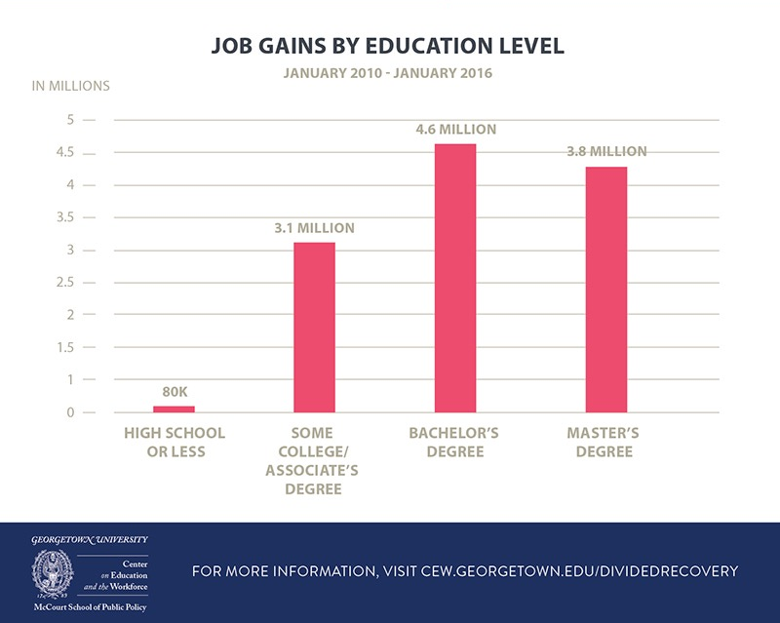
Source: https://cew.georgetown.edu/cew-reports/americas-divided-recovery (accessed August 24, 2016)

Slide 19

Less than 10 percent of children born in the bottom quartile of household incomes attain a bachelor’s degree by age 25, compared to more than 50 percent in the top quartile.
Source: http://www.ed.gov/news/press-releases/fact-sheet-expanding-college-access-through-dual-enrollment-pell-experiment (accessed August 16, 2016)

Slide 20
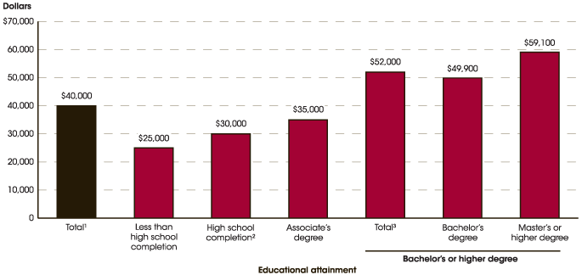
Median Annual Earnings of Full-time, Year-round Workers Ages 25–34, by Educational Attainment: 2014
Source: http://nces.ed.gov/programs/coe/indicator_cba.asp (accessed August 24, 2016)

Slide 21

“In today’s world, twenty-first-century skill demands are steadily increasing. Most high-paying jobs require additional education and training beyond a high school diploma. We must make sure that our children, particularly those who are traditionally underserved, are prepared for and have access to postsecondary education.”
–Gov. Bob Wise, Alliance for Excellent Education

Slide 22


U.S. high school graduates equal to other countries’ high school dropouts …
Listen
Source: All Things Considered (2016, March 10). Reporter Gabrielle Emanuel http://www.npr.org/programs/all-things-considered/2016/03/10/469898968 (accessed August 16, 2016)

Slide 23

Survey of Student Engagement
Of students surveyed in 2015 29% reported not being engaged, 21% reported being mostly disengaged.
Only 17% of sophomores and juniors strongly agreed that they have the opportunity to do what they do best at school.
Source: http://www.gallup.com/services/189926/student-poll-2015-results.aspx (accessed September 26, 2016)
Notes:
Gallup Student Poll 2015 “Engaged Today – Ready for Tomorrow

Slide 24
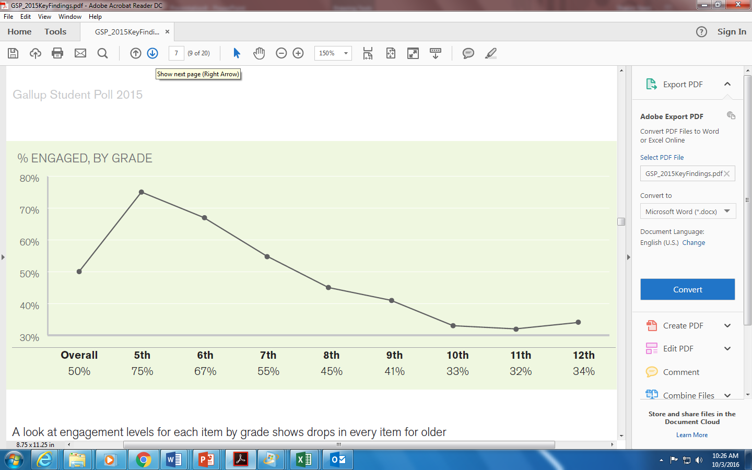
Survey of Student Engagement
Engagement decreases steadily from the fifth grade through junior high and high school.
Source: http://www.gallup.com/services/189926/student-poll-2015-results.aspx (accessed September 26, 2016)

Slide 25
What can it mean?
Rethinking High School

Slide 26

Rethinking High School: What Can It Mean?
Source: Used with permission from NewSchools Venture Fund, https://vimeo.com/167511129 (accessed August 16, 2016)

Slide 27

Across the nation, there is a desire to rethink high schools.
Source: Used with permission from XQ Super School Project, https://www.youtube.com/watch?v=G01-dI3JOfc (accessed August 16, 2016)

Slide 28
What can leaders do to change the trajectory of high school students, particularly those traditionally underserved?
?
?
?
?
?
?

Slide 29

Strengthen Conditions for Learning
29

Slide 30

How can the high school experience be changed …
… so that more traditionally underserved students are prepared for college, a career, and life?
Institute for Student Achievement’s (ISA’s)
evidence-based
whole-school reform model
Source: http://all4ed.org/webinar-event/july-23-2015/ (accessed August 24, 2016)
Notes:
Here is one approach that school leaders can use to meet the needs of the majority of our students and set more of them on a path to college course work. In order to ensure more access to dual-enrollment and early college high school programs, schools will need to change their overall approach and strengthen their core academic programs. The following is one evidenced-based approach to do so.

Slide 31




Why ISA’s Whole-School Reform Model Works
Sustainable
Collaborative
Grounded in research
Proven track record
Source: http://www.studentachievement.org/about-isa/why-isa/ (accessed September 2, 2016)
Notes:
These are four of the qualities of ISA that support lasting school improvement in schools.

Slide 32
Seven Principles of
Institute for Student Achievement
College-preparatory instructional program
Extended school day and school year
Continuous professional development
Distributed counseling
Dedicated team of teachers and counselors
Parent involvement
Continuous organizational improvement
Source: http://www.studentachievement.org/approach/the-seven-principles/ (accessed August 26, 2016)

Slide 33
Increase Access to Advanced Math and Science Courses
Thirty-three percent of high schools with high black and Latino student enrollment offer calculus, compared to 56 percent of high schools with low black and Latino student enrollment.
Forty-eight percent of high schools with high black and Latino student enrollment offer physics, compared to 67 percent of high schools with low black and Latino student enrollment.
Seventy-one percent of high schools with high black and Latino student enrollment offer Algebra II, compared to 84 percent of high schools with low black and Latino student enrollment.
Sixty-five percent of high schools with high black and Latino student enrollment offer chemistry, compared to 78 percent of high schools with low black and Latino student enrollment.
Source: http://www.ed.gov/news/press-releases/persistent-disparities-found-through-comprehensive-civil-rights-survey-underscore-need-continued-focus-equity-king-says (accessed August 26, 2016)

Slide 34

Across the nation, high schools are raising expectations by offering access to advanced high school courses and college courses for traditionally underserved students and the results are promising.
34

Slide 35

Listen to San Antonio (TX) Council Member Rey Saldaña’s Story
Source: Alliance for Excellent Education, https://www.youtube.com/watch?v=RLMoAg-iYz0 (accessed August 24, 2016)

Slide 36
Information for Leaders
Implementing Early College High Schools and Dual-Enrollment Programs

Slide 37
Rigorous Standards
When students walk across the graduation stage and are handed a high school diploma, they should be confident that they are ready for college and a career. The diploma should represent achievement of rigorous state standards.
Source: http://all4ed.org/articles/tickets-to-nowhere-new-report-exposes-lack-of-alignment-between-state-diplomas-and-college-and-career-ready-standards/ (accessed September 1, 2016)

Slide 38

ESSA Academic Standards Requirement
ESSA requires states to set challenging academic standards in reading/language arts and math that are aligned with the following:
entrance requirements for credit-bearing course work in the state’s system of higher education; and
relevant state career and technical education standards.
Source; ESSA, Sec. 1111(b)(1)
Notes:
However – The Department of Education is prohibited from mandating state standards and cannot require states to implement the Common Core.
[ESSA, Sec. 8526A]

Slide 39
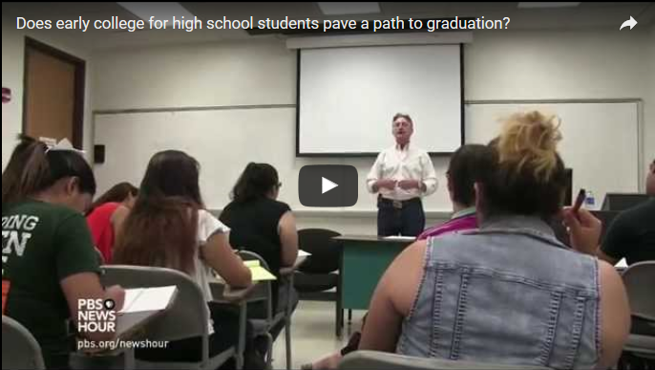
Listen to Superintendent Daniel King
Make the Case
Source: https://www.youtube.com/watch?v=aw3SGD2flno (accessed August 29, 2016)

Slide 40
What Is an Early College High School?
As defined in the Every Student Succeeds Act (ESSA):
An early college high school is a partnership between at least one local educational agency and at least one institution of higher education that allows participants to simultaneously complete requirements toward earning a regular high school diploma and earn not less than twelve credits that are
(1) transferable to the institutions of higher education;
(2) part of an organized course of study toward a postsecondary degree or credential; and
(3) provided at no cost to the participant or the participant’s family.
Source: ESSA, Sec. 8101(17)

Slide 41
What Is a Dual-Enrollment Program?
As defined in the Every Student Succeeds Act (ESSA):
A dual- or concurrent-enrollment program is “offered by a partnership between at least one institution of higher education and at least one local educational agency through which a secondary school student who has not graduated from high school is able to enroll in one or more postsecondary courses and earn postsecondary credit that –
is transferable to the institutions of higher education in the partnership
applies toward completion of a degree or recognized educational credential as described in the Higher Education Act of 1965.”
Source: ESSA, Sec. 8101(16)
Notes:
- First time federal statute has defined early college high schools and dual- or concurrent-enrollment programs. This is important because there has been such a variety in terminology used for these types of programs in the past; there was a particular push to add “concurrent” to the term “dual-enrollment” since many states use this term.

Slide 42
What Is a Concurrent-Enrollment Program?
As defined by the National Alliance of Concurrent Partnerships (NACEP):
A concurrent-enrollment program provides high school students the opportunity to take college-credit–bearing courses taught by college-approved high school teachers. It is a low-cost, scalable model for bringing accelerated courses to students in urban, suburban, and rural high schools.
Exposes students to the academic challenges of college while in their supportive high school environment, earning transcripted college credit at the time they successfully pass the course
Facilitates close collaboration between high school teachers and college faculty that fosters alignment of secondary and postsecondary curricula
Sometimes called “dual-credit,” “dual-enrollment,” or “college in the high school,” concurrent-enrollment partnerships differ from other models of dual-enrollment because high school instructors teach the college courses.
Source: http://www.nacep.org/about-nacep/what-is-concurrent-enrollment/ (accessed August 26, 2016)

Slide 43
What Does ESSA Say?:
Opportunities to Advance Access to Rigorous Course Work

Slide 44

High schools receive 10 percent of Title I funding, yet they enroll nearly one-quarter of students from low-income families.
43
Source http://all4ed.org/wp-content/uploads/2013/06/TitleIandHSs.pdf (accessed August 26, 2016)
Notes:
Wayne Riddle, Title I and High Schools: Addressing the Needs of Disadvantaged Students at All Grade Levels (Washington, DC: Alliance for Excellent Education, 2011),http://all4ed.org/wp-content/uploads/2013/06/TitleIandHSs.pdf.

Slide 45

ESSA “flips the script” on school improvement by offering funding flexibility
to support advanced
course work.

Slide 46

ESSA includes new provisions to better empower students to seize opportunities in today’s economy and prepare students for success in college and a career.

Slide 47

ESSA Opportunities: Implementing Early College High Schools
46
Districts may target Title I funds to high schools with a poverty rate of 50 percent or higher.
Source: ESSA, Sec. 1113(a)(3)(B)
Notes:
[ESSA, Sec. 1113(a)(3)(B)]
The Every Student Succeeds Act allows districts to target Title I funds to high schools.
​
Districts are allowed to lower the priority threshold to receive Title I funds from 75 percent to 50 percent for high schools.​
Districts are allowed to use the “feeder pattern” to determine poverty in high schools​.

Slide 48

48
District plans must “facilitate effective transitions … from high school to postsecondary education including, if applicable—
through coordination with institutions of higher education, employers, and other local partners; and
through increased student access to early college high school or dual- or concurrent-enrollment opportunities, or career counseling to identify student interests and skills.”
Source: ESSA, Sec. 1112(b)(10)
Notes:
Also:
- Student participation in college course work must be included in state report cards
- Local education agency plans must include strategies to help students transition between high school and postsecondary education, such as dual-enrollment and early college high school programs

Slide 49

Professional development funding (Title II) may be used to provide training “on effective strategies to integrate rigorous academic content, career and technical education, and work-based learning (if appropriate), which may include providing common planning time…”
Source: ESSA, Sec. 2103(b)(3)(O)

Slide 50

50
Language Instruction for Limited-English–Proficient and Immigrant Students funding (Title III) may be used to offer early college high school or dual- or concurrent-enrollment programs or courses designed to help English learners achieve success in postsecondary education.
[ESSA, Sec.3115(d)(8)]

Slide 51

51
Direct Student Services funding may be used to provide for enrollment and participation in academic courses not otherwise available … including advanced courses and career and technical education course work that is aligned with challenging state academic standards and leads to industry recognized credentials.
ESSA, Sec. 1003A(c)(3)(A)
Notes:
[ESSA, Sec 1003A(c)(3)(A)]

Slide 52
How May Federal Funds Be Used?
  The Every Student Succeeds Act (ESSA) enables states and local education agencies to utilize federal funds to support college course work for
  students attending schools in need of improvement (Title I);
  students attending high-poverty schools (Title I);
  students from low-income families attending private schools (Title I);
  teacher professional development (Title II);
  English language acquisition (Title III); and
  academic enrichment (Title IV).

Slide 53
Moving from Policy to Practice:
Promising Approaches
An overview of program results and successful approaches in
early college high school and dual-enrollment programs

Slide 54
High School to College Transition Made Easier
Early college high school programs do more than provide access to college credits. They enhance a college-going mindset and strengthen skills needed in college, such as
Self realization
Time management
Research and notetaking
College orientation
Source: http://files.eric.ed.gov/fulltext/EJ943719.pdf (accessed September 6, 2016)

Slide 55
“
Early college high schools are a prime example of deeper learning in practice. At their best, these innovative, hybrid models marry the intellectual challenge, freedoms, and standards of higher education with the support systems appropriate to help younger scholars develop and achieve.
”
Clara Botstein, Associate Vice President, Bard Early Colleges
Early college high schools—getting all kids ready for college, a career, and life
Source: http://deeperlearning4all.org/essa/supporting-deeper-learning-at-early-college-high-schools (accessed September 6, 2017)

Slide 56
Early College High Schools:
Removing Obstacles—Changing Lives
There are 280 early college high schools, 32 states, 80,000 students
90 percent of students graduate from high school (compared to 78 percent of students nationally)
94 percent of graduates earn at least some college credits
Source: Jobs for the Future, http://www.jff.org/sites/default/files/ECHS-Week-2016-one-pager-021216.pdf (accessed August 24, 2016)

Slide 57
Early College High Schools:
Removing Obstacles—Changing Lives
71 percent of high school graduates enroll in college immediately after high school
30 percent of students earn an associate’s degree or college certificate
38 is the average number of college credits early college high school students earn
Source: Jobs for the Future (2016). http://www.jff.org/sites/default/files/ECHS-Week-2016-one-pager-021216.pdf (accessed August 24, 2016)

Slide 58


Expanding Opportunities:
Dual-Enrollment Programs
1.4 million high school students took over 2 million college courses from postsecondary institutions nationwide in School Year (SY) 2010–11. This represents 10 percent of high school students, higher in upper grades given the vast majority of students taking these classes are juniors and seniors. In Iowa, half of high school graduates complete at least one college course.
Even higher growth rates were seen in schools where a majority of students are ethnic or racial minorities (12 percent), rural schools (12 percent), and in the Northeast and Southeast regions of the country (9 percent).
Source: National Alliance of Concurrent Enrollment Partnerships, www.nacep.org/research-policy/fast-facts/ (accessed August 24, 2016)ed
Notes:
Source: National Alliance of Concurrent Enrollment Partnerships www.nacep.org/research-policy/fast-facts/ (accessed August 24, 2016)

Slide 59


Expanding Opportunities:
Dual-Enrollment Programs
Dual-enrollment programs had an annual growth rate of more than 7 percent during the intervening eight years since SY 2002–03.
Thirty percent of dual-enrollment courses are in career and technical education.
Source: National Alliance of Concurrent Enrollment Partnerships, www.nacep.org/research-policy/fast-facts/ (accessed August 24, 2016)
Notes:
Source: National Alliance of Concurrent Enrollment Partnerships, www.nacep.org/research-policy/fast-facts/ (accessed August 24, 2016)

Slide 60
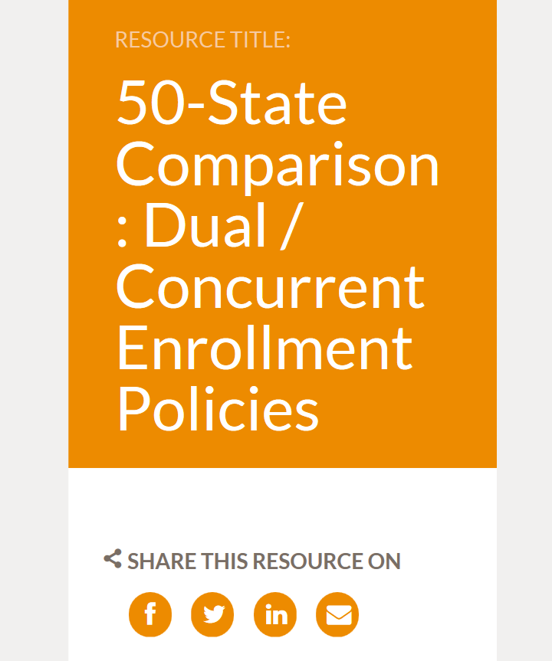
Find Information on State Approaches to Implementation
50-State Comparison: Dual / Concurrent Enrollment Policies
Staff contact
Jennifer Dounay Zinth
jzinth@ecs.org
303.299.3689
Source: http://www.ecs.org/dual-concurrent-enrollment-policies/ (accessed on August 10, 2016)

Slide 61
“
Early college pathways, which provide students with an opportunity to earn college credits before leaving high school, are a proven promising approach for raising college readiness and creating greater alignment between secondary and postsecondary education. Unfortunately, these opportunities are not equitably distributed across all communities and school districts, and low-income students and youth underrepresented in higher education are participating the least in college courses as high school students.
”
Source: Jobs for the Future, Dual Enrollment Policies that Support Early College Strategies for Low-Income Youth, http://application.jff.org/dualenrollment/ (accessed August 24, 2016)

Slide 62
ED Funds Dual-Enrollment Programs
Through Pell Grant Experiment
U.S. Department of Education (ED) initiative will allow forty-four postsecondary institutions to participate in an experiment that—for the first time—allows students taking college-credit courses to access federal Pell Grants as early as high school.
Estimated 10,000 high school students
$20 million in federal Pell Grants
Nearly 80 percent of sites are community colleges
Source: http://www.ed.gov/news/press-releases/fact-sheet-expanding-college-access-through-dual-enrollment-pell-experiment (accessed September 7, 2016)
Notes:
Department of Education is inviting 44 postsecondary institutions to participate in an experiment that – for the first time – allows students taking college-credit courses to access Federal Pell Grants as early as high school. As part of this experiment, an estimated 10,000 high school students will have the opportunity to access approximately $20 million in Federal Pell Grants to take dual-enrollment courses provided by colleges and high schools throughout the nation. Nearly 80 percent of the selected sites are community colleges.

Slide 63

Moving from Grass “Tops” to Grass “Roots”: Policies, Procedures, and Practices

Slide 64
What Do Leaders Need to Consider?
Policies
Procedures
Practices
Do your state, district, or schools have defined policies around early college high schools or dual-enrollment programs?
What procedures and practices currently support implementation efforts?
What procedures and practices are needed to support implementation efforts?

Slide 65
Successful Implementation Requires Careful Planning and Effective Communication
The goals of early college high school/dual-enrollment programs are important but we must take care to ensure that educators, students and parents are well-informed and can mitigate risks and opportunities related to
college credit acceptance policies;
use of Pell Grant funds; and
credit transfer policies at in-state and out-of-state colleges and universities.
Source: http://www.edweek.org/ew/articles/2016/09/07/are-dual-enrollment-programs-overpromising.html
(accessed September 7, 2016)

Slide 66
One Approach to Implementation
Education leaders recommend a “guided pathway" approach, in which more colleges and universities would spell out which courses will transfer for credit, and high school counselors use that information to help students create "sequences of courses that are planned and thoughtfully designed" so they'll be more likely to transfer, said Joel Vargas, Jobs for the Future.
Source: http://www.edweek.org/ew/articles/2016/09/07/are-dual-enrollment-programs-overpromising.html (accessed September 7, 2016)

Slide 67
Additional Approaches that May Mitigate Student Risk
Statewide policies require dual-enrollment credits be treated for transfer credit in the same manner as credits earned at the receiving instruction (twenty-two states in 2014).
Statewide policies require high schools to provide information to students and parents, prior to registration, on eligibility, costs, participating institutions of higher education, process for awarding credits, and supports available to families.
Source: http://www.ecs.org/clearinghouse/01/10/91/11091.pdf, pg. 15 (accessed September 7, 2016)

Slide 68
Examples of Policies
Student eligibility and participation; funding prioritized for the most in-need students to participate
Transferability of credits earned in dual- or concurrent-enrollment/early college high schools with state systems of higher education
Course design and grading
Transportation to off-site classes
Policies

Slide 69
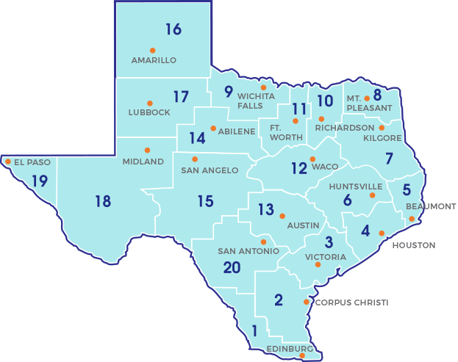
Early College High Schools: Texas
The following links are about the laws and rules for early college high school programs:
General Appropriations Act, Article III, Rider 57, 2013
Texas Education Code §29.908
Texas Administrative Code §4.161
19 Texas Administrative Code Chapter 102 Educational Programs Subchapter GG: Commissioner's Rules Concerning Early College Education Program
Policies
Source: http://txechs.org/find-an-echs-in-texas/ (accessed August 24, 2016)
Notes:
Under the authority of Texas Education Code (TEC) §29.908(b) and Texas Administrative Code (TAC) §102.1091, the TEA developed a designation process for early college high schools.
Source: http://tea.texas.gov/Curriculum_and_Instructional_Programs/College_and_Career_Readiness/Early_College_High_School/ (accessed August 24, 2016)
Source: http://txechs.org/find-an-echs-in-texas/ (accessed August 24, 2016)

Slide 70
Dual-Enrollment Programs: Colorado
Policy language
Impact
Concurrent-enrollment programs continue to see sustained increases in participation, up 13 percent statewide with 23,127 students participating in School Year (SY) 2014–15.
Statewide, 94 percent of districts and 84 percent of high schools offer concurrent- enrollment programs.
More than half of students who participated in ASCENT in SY 2014–15 were Hispanic, a minority group that is historically underrepresented in postsecondary education.
The majority of concurrent-enrollment hours taken by students (93 percent) were passed in SY 2014–15 (up from 89 percent in the previous year).
More than 1,200 students in concurrent-enrollment programs earned some type of postsecondary credential in SY 2014–15.
More than half of students who participated in ASCENT in SY 2014–15 were Hispanic, a minority group that is historically underrepresented in postsecondary education.
Students who participated in dual-enrollment programs in high school had higher first-year credit hour accumulation, grade point averages, and retention rates in college.
In May 2009, the Colorado State Legislature passed House Bill 09-1319 and Senate Bill 09-285, the Concurrent-Enrollment Programs Act.
Policies
Source: https://www.cde.state.co.us/postsecondary/concurrentenrollment (accessed August 24, 2016)

Slide 71
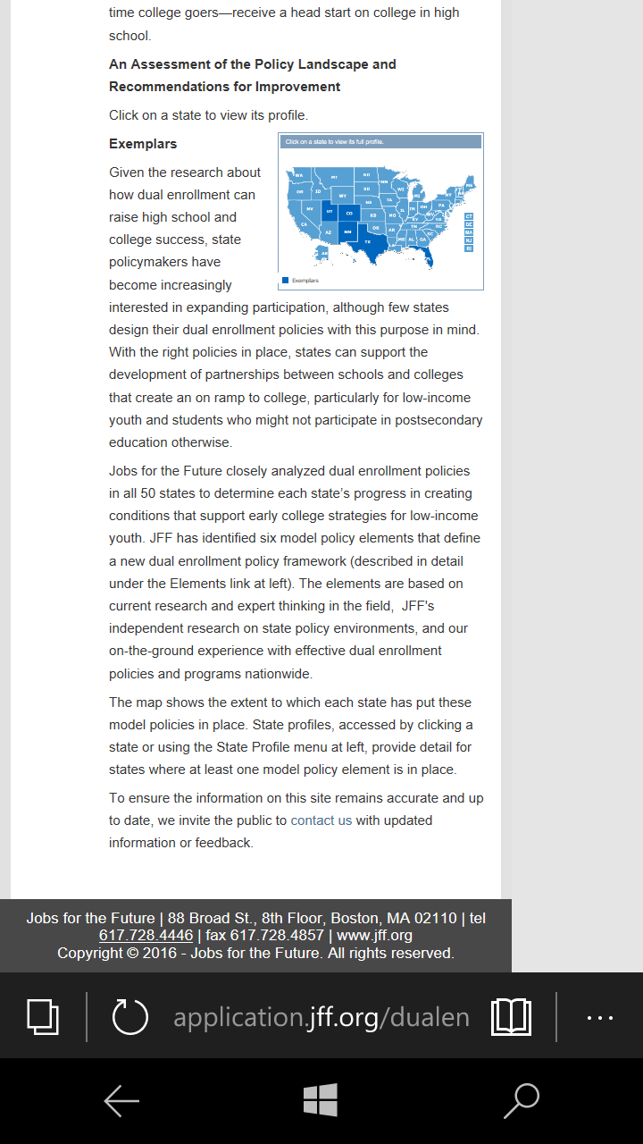
Study Analyzes U.S. Enrollment Policies
Dual-enrollment policies that support early college strategies for youth from low-income families.
Source: http://application.jff.org/dualenrollment/ (accessed August 24, 2016)
Notes:
Source: http://application.jff.org/dualenrollment/ (accessed August 24, 2016)

Slide 72
Examples of Procedures
Selection of faculty or high schools teachers
Space/site selection
Course withdrawal
Selection of institutions of higher education as partners
Procedures

Slide 73
Not Left to Chance
What can districts and schools do to provide more support and guidance for students?
manage college going pathway;
provide direction and guidance;
teach study skills explicitly;
incentivize and bolster confidence; and
monitor student progress closely.
Practices
Source: http://files.eric.ed.gov/fulltext/EJ943719.pdf (accessed September 6, 2016)

Slide 74
Examples of Practices
Establishment of a college-going culture and high expectations for all students.
Training of school counselors on the initiative.
Incentives to increase participation of high school and college faculty who are great teachers.
Close collaboration between secondary and postsecondary education programs.
Practices

Slide 75
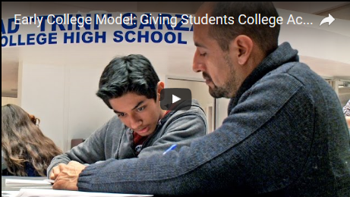
Practice in Action
Practices
Source: https://www.youtube.com/watch?v=STALnCMAyQo (accessed August 24, 2016)

Slide 76
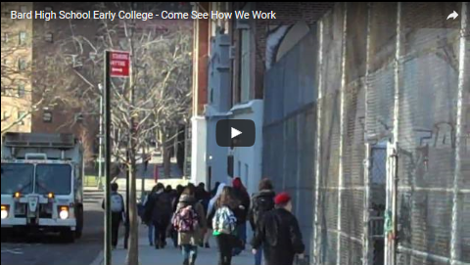
A Closer Look: Students Speak
Practices
Source: : https://www.youtube.com/watch?v=5pltIo1DodQ (accessed August 29, 2016)

Slide 77
Consider Your Policies, Procedures, and Practices
Policies
Procedures
Practices
Notes:
This primer provides you with ESSA policy that can significantly impact the way you design your high school program for college and a career. It also offered models of dual-enrollment, concurrent-enrollment and early college experiences. Additionally there are resources for reviewing and learning. And then there are ideas and for planning and implementation.
The Alliance for Excellent Education remains excited about the possibilities for excellent high schools in the United States and the staff stand ready to support you as thought partners and technical assistance providers in your school reform initiative or in making small changes in policy, procedures and practices to strengthen learning for students that allows them to be “college and career ready.” The Alliance is firm in its belief that students of color, students receiving special education services, English language learners, and other populations traditionally underserved need equitable access to college- and career-preparation programs with the outcome of proficiency in college- and career-ready skills.

Slide 78
Research and Additional Resources

Slide 79
Research and Additional Resources
Alliance for Excellent Education
“Positive Double Dipping: More Students from Low-Income Families Take College Classes in High School When States, Districts Pay the Costs” http://bit.ly/2a5ViA0
Education Commission of the States
“State Approaches to Funding Dual-Enrollment” http://www.ecs.org/clearinghouse/01/18/92/11892.pdf
50-State Comparison: Dual/Concurrent Enrollment Policies http://www.ecs.org/dual-concurrent-enrollment-policies/
50-State Comparison: Dual/Concurrent Enrollment Policies, individual state profiles http://www.ecs.org/dual-concurrent-enrollment-state-profiles/

Slide 80
Research and Additional Resources (cont’d)
U.S. Department of Education
Every Student Succeeds Act page. http://www2.ed.gov/policy/elsec/leg/essa/index.html?src=essa-page
Fact Sheet—Expanding College Access Through the Dual-Enrollment Pell Experiment http://bit.ly/1XuOXxb
Fact Sheet—Department of Education Launches Experiment to Provide Federal Pell Grant Funds to High School Students Taking College Courses for Credit http://bit.ly/1jXy4LW
Report—Dual Enrollment: Lessons Learned on School‐Level Implementation http://bit.ly/2aApGA4
Report—Dual Enrollment Programs and Courses for High School Students at Postsecondary Institutions: 2010–11 http://bit.ly/2ay1M88

Slide 81
Research and Additional Resources (cont’d)
U.S. Department of Education (cont’d)
Fact Sheet—Dual Enrollment Programs and Courses for High School Students at Postsecondary Institutions: 2010–11 http://bit.ly/2aCZPom
PowerPoint—The U.S. Department of Education’s Experimental Sites Initiative Dual Enrollment January 2016 http://bit.ly/2akWQoC
Fact Sheet/Article—High Schools and Career Readiness: Strengthening the Pipeline to the Middle Class http://bit.ly/1fgoSsZ
Report—Who Will Succeed and Who Will Struggle? Predicting Early College Success with Indiana's Student Information System http://bit.ly/2ay46fq
Report—Early College, Early Success: Early College High School Initiative Impact Study http://bit.ly/2aD22QW

Slide 82
Research and Additional Resources (cont’d)
Foundation for Excellence in Education
Webinar—Implementing ESSA: From Compliance to Opportunity https://www.youtube.com/watch?v=i4zZP5YFOCM
Institute for Educational Sciences
WWC Review of the Report “Early College, Early Success: Early College High School Initiative Impact Study” http://ies.ed.gov/ncee/wwc/pdf/single_study_reviews/wwc_hchs_031114.pdf
WWC Review of the Report “The Impact of Dual Enrollment on College Degree Attainment: Do Low-SES Students Benefit?”
http://ies.ed.gov/ncee/wwc/pdf/single_study_reviews/wwc_dual_121713.pdf

Slide 83
Research and Additional Resources (cont’d)
National Association of Secondary School Principals
Webinar—Title I provisions in ESSA https://www.youtube.com/watch?v=cNRDcxGGGog
Webinar—Title II provisions in ESSA https://www.youtube.com/watch?v=WYiAt5NqqsQ
Webinar—Title IV provisions in ESSA https://www.youtube.com/watch?v=k7fmIo_6lW4&feature=youtu.be
National Conference of La Raza
Comments on the Retention and Completion of Latino Students in Higher Education http://publications.nclr.org/bitstream/handle/123456789/1416/Memo%20No.%2011?sequence=12&isAllowed=y
Grad Nation (see notes field)
Building a Grad Nation: Progress and Challenge in Raising High School Graduation Rates http://www.gradnation.org/sites/default/files/civic_2016_full_report_FNL2-2_0.pdf
Notes:
Grad Nation: not certain how to cite the report – from page 3 of the report
A Report by: Civic Enterprises Everyone Graduates Center at the School of Education at Johns Hopkins University In Partnership with: Alliance for Excellent Education America’s Promise Alliance Authored by: Jennifer L. DePaoli Robert Balfanz John Bridgeland Data Analysis by: Vaughan Byrnes Mark Pierson Edited by: Erin Ingram Kathleen McMahon Joanna Hornig Fox Mary Maushard A

Slide 84
Planning and Implementation Tools

Slide 85
Reflections
If all goes as planned, what would be different as a result of this work?
How will you know you are on track to accomplish your outcomes?
How will you know when you have achieved these outcomes?

Slide 86
Data-Driven Planning
In determining if early college high school/dual-enrollment approaches are a possible approach or are effectively being implemented in your states, districts, or schools, consider the following:
Overall population
Participation in early college high school or dual-enrollment programs, by subgroup
Participation in advanced courses (Advanced Placement/International Baccalaureate, math/science classes) by subgroup
“Success rate” of students enrolled in advanced courses, early college high school or dual-enrollment programs, by subgroup
Existence of policies that support student success in advanced course work (e.g., mentoring, tutoring, counseling)

Slide 87
Data Collection Tool
 | White | Black | Hispanic | Asian/Pacific Islander | Other | SWD | SRFRM | ELL
Number or percentage of student population
Graduation rate
Enrollment in special education
Participation in gifted programs
Participation in AP/IB
Participation in early college high school
Participation in dual-enrollment programs
Enrollment in postsecondary programs
Notes:
SWD: Students with Disabilities
SRFRM: Students Receiving Free or Reduced Meals
EEL: English language learnings.

Slide 88

Listen to San Antonio (TX) Council Member-Rey Saldaña’s Story
Source: Alliance for Excellent Education, https://www.youtube.com/watch?v=RLMoAg-iYz0 (accessed August 24, 2016)

Slide 89
Tool: Rey Saldaña Video
Watch council member Saldaña’s video and consider the following:
How does he characterize his high school experience?
Who were the adults during his high school career who helped him believe and achieve his goals?
To what does he attribute his success?
What implications does his story have for the work you may be doing or planning related to early college high school/dual-enrollment programs?

Slide 90
Policies, Procedures, and Practices
In what ways have the moral and economic imperative about increasing access to advanced course work been communicated to educators, parents, students, and other stakeholders in your community?
Provide examples of the research findings related to the impact on students.
What types of professional development may be needed to support educator involvement and buy-in?

Slide 91
Supporting Educators
Provide educators with information about the research related to access to advanced course work for traditionally underserved students.
What types of questions or concerns have staff shared?
Does your staff need additional professional development to better support the implementation of early college high school/dual-enrollment programs?
In what ways can you partner with a college or university in program implementation, evaluation, and support for staff and students?

Slide 92
Evaluating Success: Things to Consider
How will the early college high school/dual-enrollment programs be shared with stakeholders (educators, parents, students, colleges, business community, etc.)?
What data points will best support an analysis of the implementation of early college high school or dual enrollment programs?
In what areas can existing partnerships or expertise be leveraged?

Slide 93
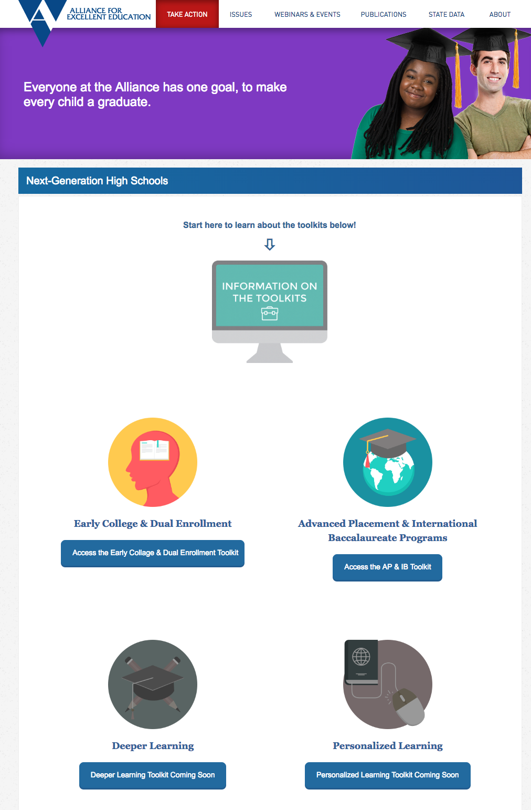
For additional information and resources on next-generation high schools, visit http://all4ed.org/nghs.

Slide 94
Thank You!
For further information and technical assistance support, please email us at alliance@all4ed.org.
All4ed.org
Alliance@all4ed.org
@all4ed

