Slide 1
Curriculum-Embedded Performance Assessment
Lauren Monowar-Jones January 2014

Slide 2
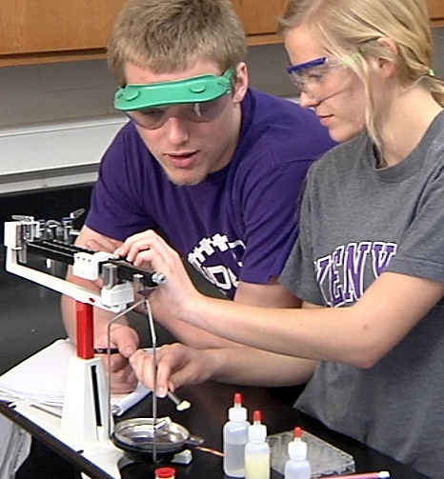
The Ohio Performance Assessment Pilot Project
Notes:
The Ohio Performance Assessment Pilot Project is a pilot that has come a long way. We started in 2008 with Stanford and Curriculum-Embedded Performance Assessments and have grown a unique model that supports teaching in learning in a way that is very positive.
One of my colleagues describes this project as a large scale assessment system but in miniature because it has all of the elements of a large scale assessment system.
To give you an idea of the scope of this project:
We have engaged teachers in grades 3 through 12.
We have written tasks in Math, English Language Arts, Science, Social Studies and Career Technical Pathways.
We have piloted 140 learning tasks and 148 assessment tasks
We have trained 686 teachers to provide instruction using the project model and trained as many teachers to score these tasks.
We have scored 23438 student responses –always scoring them at least twice
We have developed Teacher training materials for in-person sessions and for electronic, on-demand sessions
And we have documented the project using an outside evaluator, written papers and even used a videographer.
In general, we have experimented with most of the aspects of an operational large scale assessment system

Slide 3
The Task Dyad Learning System
Notes:
The model we are piloting is the Task Dyad Learning System. The dyad is a pair of closely coupled tasks comprised of an assessment task that is used to measure performance (against content standards) and a learning task that is used to provide a context for the student to learn the skills that will be assessed.
Learning is comprised of instruction, often direct instruction, student practice, often using the same software interface as the assessment, and the teaching practice of making observations, and giving additional instruction or feedback to either the collective of students or to individual students, as necessary. The intent is to ensure that all students have an opportunity to learn that which will be assessed and some of the efforts at teacher PD was in collecting observations of student practice and reinstructing or giving feedback to students. The objective of this model is not to catch the student “not knowing” during the assessment but to catch the student showing that she or he has the skills implied by the content standards and instructed with the aid of the learning task.
To reiterate, the relationship between the Learning Task and the Assessment Task is like the relationship between what you do with a driver’s permit to pass the driving test. (Driving test analogy)

Slide 4
The Pilot
Development of Dyads
Scoring Dyads
Piloting Dyads
Field Testing Dyads
Online Professional Development
Analysis of Data
Scaling Up
Notes:
So far, in this pilot, we have successfully developed Learning and Assessment Tasks. Our vendor, Measured Progress did this all at first, now we have teachers writing the Learning Tasks and coaches writing Assessment Tasks (for the middle school pilot) with a good level of success.
We have piloted dyads with six different groups of teachers and students in grades 3 – 12 in each of the four major content areas and some career technical pathways.
Teachers who have piloted have also scored their own assessment tasks in a double-blind situation so that they cannot tell if the student work is one of their own students (most of the time). One of the attractive features of the initial Gates funded project was the use of teachers as raters. When teachers are taught to score, that experience sharpens the teacher’s understanding of the item, the scoring process, and the content standards. More over, when teachers score student taught by others, the teacher might see something in the student’s response that can be used with her/his own student next season. Some of the early teacher scoring training and scoring of student responses took so long that it was projected that scoring might take days of teacher time. We have worked to define the assessment tasks (and rubrics) to reduce time to score. This process now takes about one day to complete for any group of teachers.
We have field tested dyads that were piloted and revised with teachers who did online training for implementation. Those field test teachers also scored their own students’ work and the work of other students in a scoring event that took only one day to complete.
We have developed a set of online professional learning modules to prepare teachers to implement the dyads in their classrooms and we have modified these based on user feedback. We are on our third trial this month.
We have collected a lot of very interesting data. We did some experiments. We collected data that should tell us whether it matters if you teach the Learning Task or not. We have collected data to tell us whether it matters if you are trained to score in a face-to-face scenario or online. We have collected data to tell us whether teachers are biased for or against their own students when they score. We are also looking at performance of students on the dyads as compared to their performances on the state end of year assessments.
Finally, we are scaling up. We have a model and a vendor who is going to help us implement the scaled-up version of this model. Our plan is to be in full operational mode by spring 2015.

Slide 5
Lessons Learned
1
Face-to-face professional learning is most effective.
Online professional learning must include group work to be effective.

Slide 6
Lessons Learned
2
Technology is a big challenge.
Teachers and technology specialists need to embrace access for all.

Slide 7
Lessons Learned
3
The light bulb moment
When teachers score student work, teaching improves . . . quickly.

Slide 8
Lessons Learned
4
Students love technology
Teachers need to learn how to use technology effectively to support learning.

Slide 9
Lessons Learned
5
Curriculum-embedded performance assessment requires best practices to be effective.
Teachers need training that supports using these practices and time to be reflective.

Slide 10
Challenges
Online delivery is a new challenge.
Teaching without knowing all the answers.
Keeping tasks and goals and rubrics aligned.
Notes:
Lauren, I moved the text to improve the visual.

Slide 11
State Model
Teachers create Learning Task shells at state summer institutes.
Vendors finish off Learning Tasks and create Assessment Tasks.
Teachers score Assessment Tasks, moderators train.

Slide 12
education.ohio.gov

Slide 13
Social Media
Ohio Families and Education
Ohio Teachers’ Homeroom
ohio-department-of-education
storify.com/ohioEdDept
@OHEducation
OhioEdDept

