Slide 1


Digital Learning Day
Engaging Students, Celebrating Teachers, Creating Better Schools
www.DigitalLearningDay.org

Slide 2


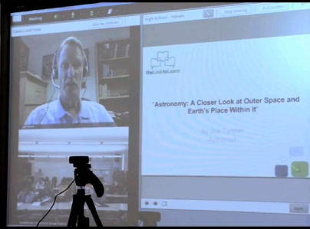
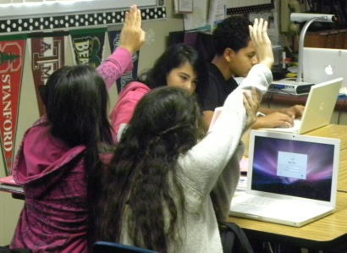
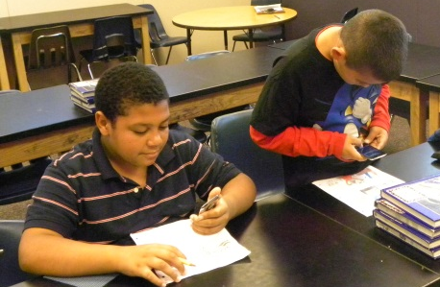
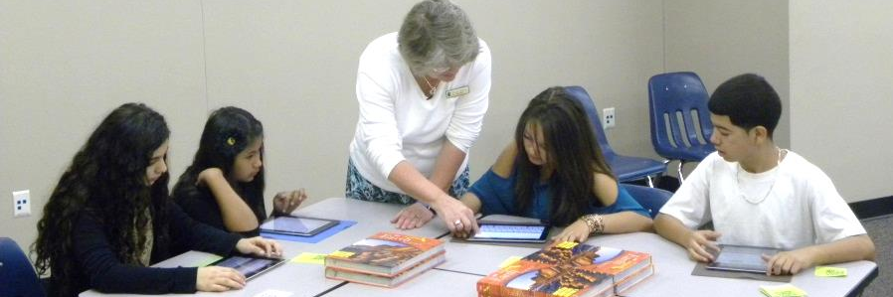
Goals:
Increase Awareness
Support Teachers and other staff
Why Digital Learning Day?
Digital Learning Makes a Difference
Shift to Personalized, Student-Centered Learning
Empower Teachers with Tools to Succeed
Prepare Students for College and Career
www.digitallearningday.org

Slide 3
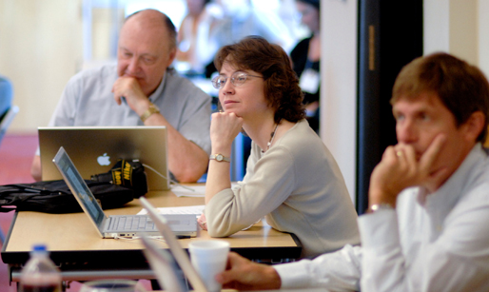

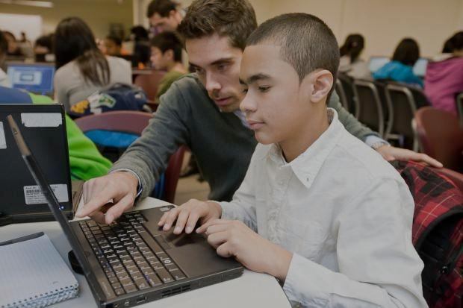
Digital Learning Is…
Any instructional practice that effectively uses technology to strengthen the student
learning experience.
Professional Learning
Collaboration
Anytime, Anywhere
Data Assessment
Learning Management Platforms
Blended Learning
Adaptive Software
Online Learning

Slide 4
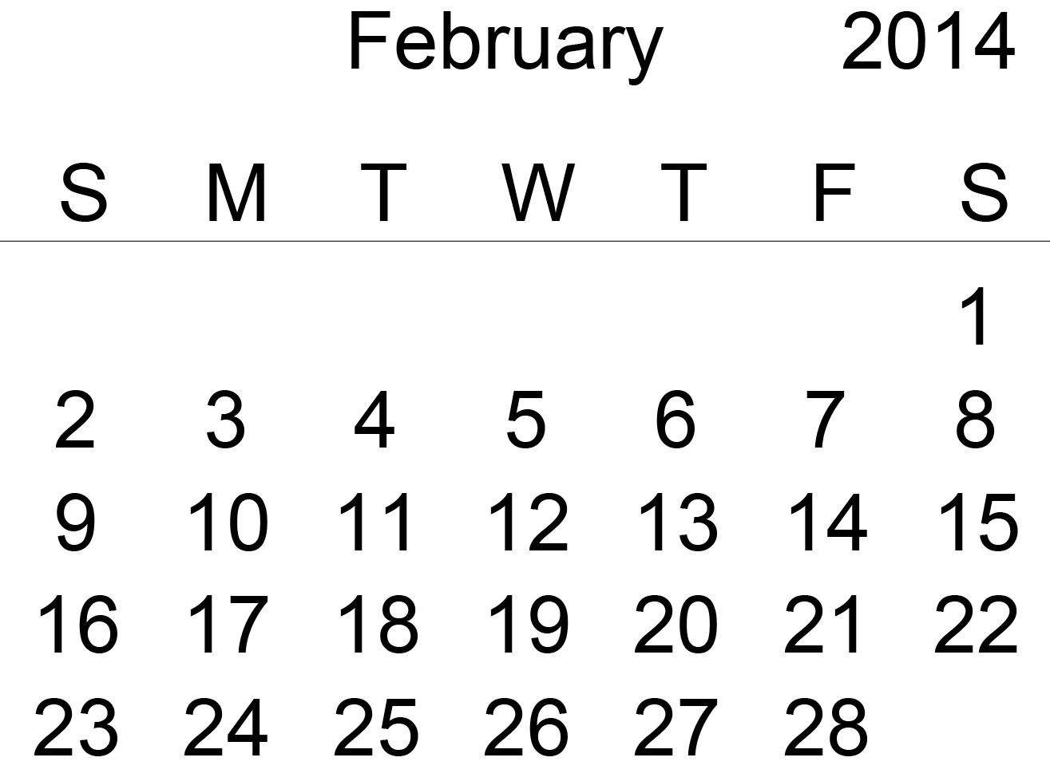
Where to Begin?
Events for Feb. 5
Events that can kick off on Feb. 5
Anytime!

Slide 5
How To Participate: Digital Learning Day
Community Outreach
Tech Showcase
Tours
Let Students Lead
Student-created videos
Survey students on preferred learning modes
Connect!
Twitter Chat
Skype Chat
Try Something New
Student Demonstrations
Support Your Teachers
Teacher-led “Appy” Party
Google Hangout
Digital Literacy Workshop
Shift Learning
Project-Based Learning Challenge
Students Hand Out Awards
Afterschool Programs
Student-created content
Take an Online Course
Visit other classrooms/sites
Flip Class For a Day
Visit State Capitol or School Board
Notes:
What’s your goal? What’s your challenge? What’s your status?
Pikesville HS in Baltimore – Don’t Worry Be Appy Party
Meet Jackie Torrelli, a fifth grade teacher, from Folger McKinsey Elementary School in Severna Park, Maryland. She has developed a cross-cutting project to help her students learn persuasive writing, math, science, and social studies while advocating for the use of digital learning in her school. She is hosting “Folger McKinsey's Apprentice Challenge” – a program that offers team building, communication and collaboration, business and critical thinking as well as addresses core language, math and science standards.

Slide 6
How To Participate: Digital Learning Day
Learn
Watch some of our videos
Read about 2013’s celebrations
Join
Sign up for our email updates with tips and ideas
Spread the word!
Celebrate
Plan an event
Add your event to our website
Check out other events near you!
Share
Invite parents, lawmakers, the media
Tell us your digital learning story
Make a video of your celebration and share it with us!
Check out our activities & toolkits
Explore
Try out a new tool
Get connected on social media

Slide 7


Join the Wave of Innovation!
Everyone Is Welcome!
Principals
District Leaders
Educators
School Librarians
Parents
Students
Businesses
Public Libraries
State Leaders
National Leaders
It’s Easy, It’s Free, and It Takes Less Than Five Minutes!

Slide 8



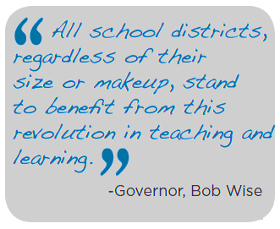
Learn & Explore
  Visit DigitalLearningDay.org for free lesson plans, toolkits, and to explore showcases of technological success in schools!
  Watch the National Event Live from the Library of Congress!
  Check out the Great Ideas and Get Started sections of the website to find valuable resources for teachers, school librarians, principals, district leaders, and members of the community.

Slide 9




Spread the Word
Share Governor Bob Wise's video announcing the third annual Digital Learning Day.
Send an Email Announcement to your districts, schools, or community members.
Send an Email or Letter to Parents.
Post the Digital Learning Day button on your website.
Hand out Digital Learning Day flyers.

Slide 10


Ways to Participate
Interested in Using Technology for Learning? Start a conversation!
School Board Meetings
Professional Learning Communities
Host an Event
Share this Presentation
Share the Digital Learning Day Flyer
Post the Digital Learning Day Button on your Website

Slide 11

Ways to Participate
Know your way around a laptop, but want to do more?
Try something new!
Share Interactive Lessons
Participate in the Nationwide Digital Learning Day Challenge
Access our Toolkits
Flip Learning for a Day
View our Monthly Webinars
Join our Email List

Slide 12

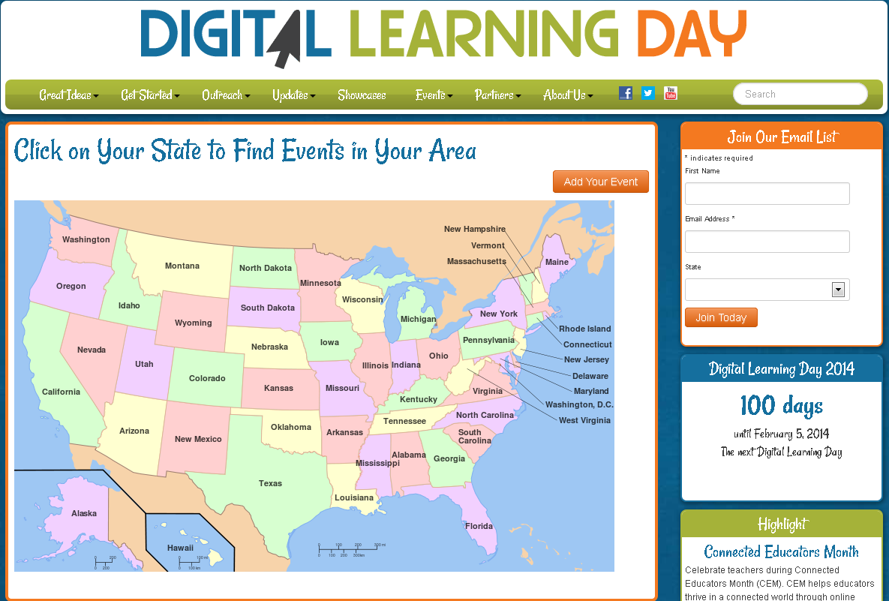

Ways to Participate
Share Your Event and Showcase Your Successes!
Add Your Event to Our Website!
Submit a Video or Blog Post
Participate in our National Town Hall Meeting
Plan a Showcase for your Local Leaders or Legislators
Host your Own Digital Learning Day Celebration

Slide 13

